Slide 1
Endoscopic Ultrasound Primer for Endoscopy Nurses
R.A.Singh MD FRCPC AGAF
Clinical Assistant Professor. Division of Gastroenterology, UBC

Slide 2
Disclosures
Speaker Honorarium: Takeda
Abbvie
Janssen
Pentax
Clinical Research Takeda
Gilead
Celgene
Janssen

Slide 3
Disclosures
Grants from Canadian Association of Gastroenterology, Royal College of Physician and Surgeons and Pentax for EUS training

Slide 4
Agenda
Basics of EUS
Diagnostic Uses of EUS
Therapeutic Uses of EUS
Practical Nursing Advice
Questions

Slide 5
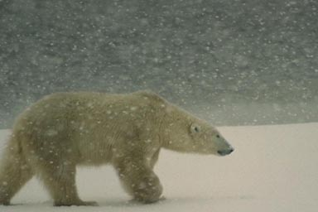
“ Polar bear in a snow storm”

Slide 6
Basics
Ultrasound image produced by US waves which are reflected back to the transducer as echoes
Reflection occurs due to acoustic impedence
A large difference of acoustic impedence between two tissues leads to greater reflection and poor transmission

Slide 7
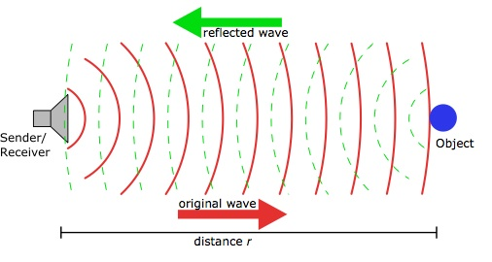
Ultrasound Mechanics

Slide 8
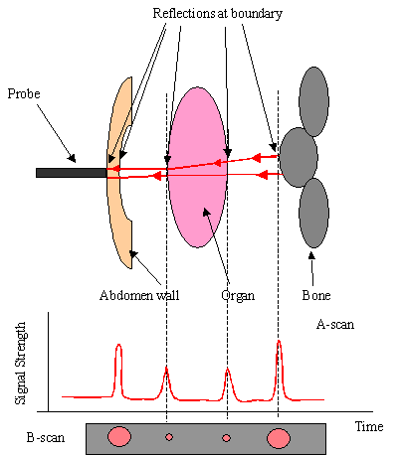
U/S Mechanics

Slide 9
Basics
Echoendoscope is an endoscope with an ultrasound transducer at the tip
Radial or linear ultrasound devices available
Standard EUS transducers operate from 7.5-12 MHz
Higher the frequency,lower the penetration
Linear array scopes allow FNA by real time visualization of the biopsy needle

Slide 10
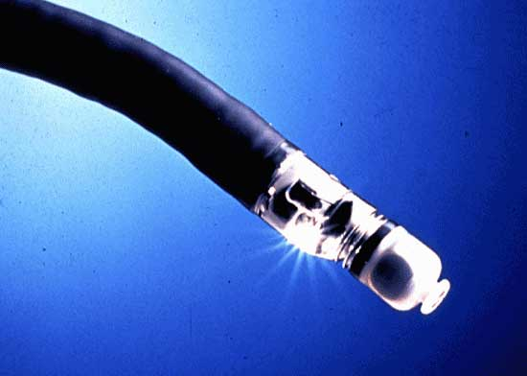

Slide 11
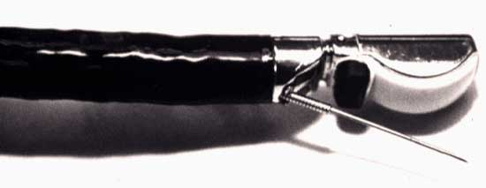

Slide 12
Basics
Acoustic coupling is achieved by a water filled balloon at the tip of the echoendoscope
EUS poor at delineating air filled structures or bone ( eg anterior mediastinum)
Artifacts occur as in abdominal US

Slide 13
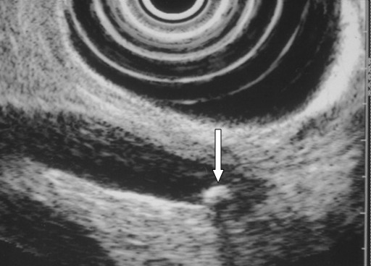
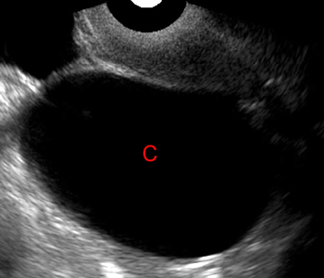
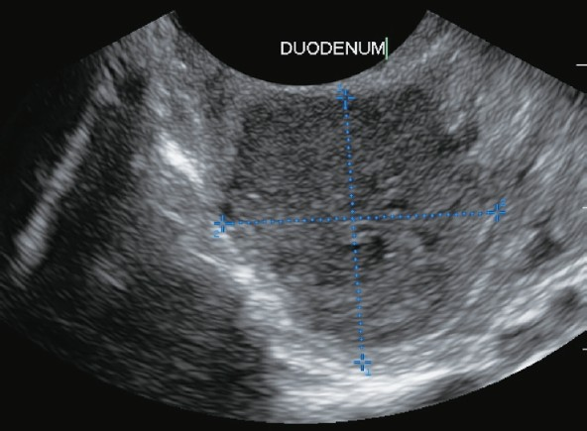
EUS Imaging
Anechoic
Hyperechoic
Hypoechoic

Slide 14
Basics
Standard echoendoscopes image five layers of the gastrointestinal wall:
Superficial mucosa ( hyperechoic)
Deep mucosa ( hypoechoic)
Submucosa ( hyperechoic)
Muscularis propria ( hypoechoic)
Serosa (hyperechoic)

Slide 15
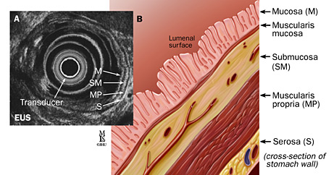

Slide 16
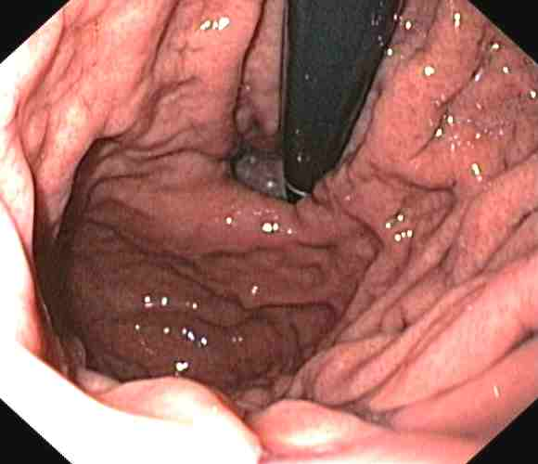

Slide 17
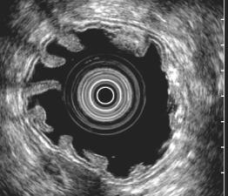

Slide 18
Why do we need EUS?: Diagnostics
Improved diagnostic accuracy in staging a variety of tumours
Esophageal, gastric, pancreatic/biliary, rectal and NSCLC
Benign lesions such as sub-epithelial lesions, chronic pancreatitis and CBD stones best evaluated by EUS
Tissue acquisition

Slide 19
Why do we need EUS?: Therapeutics
Celiac Plexus Blockade or Neurolysis
Pseudocyst or Necrosis Drainage
Biliary Access
Future needs include local chemotherapy and RFA (radiofrequency ablation)

Slide 20
Basics: Tumor Staging
TNM classification is used to stage tumors with EUS:
T1 Extension into mucosa/submucosa
T2 Extension into but not beyond layer 4
T3 Spread beyond layer 4 but not surrounding structures
T4 Invasion of surrounding structures or vessels
Nodal staging are specific to type of tumors

Slide 21
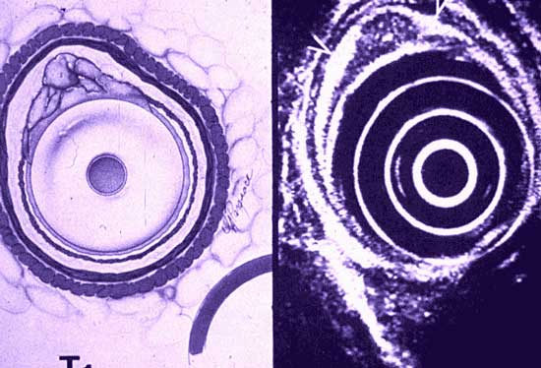
Esophageal T1 Lesion

Slide 22
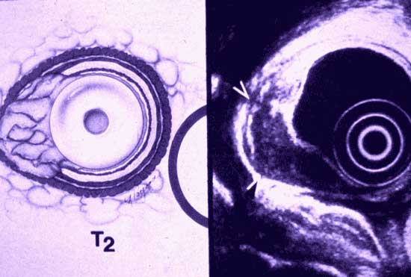
Esophageal T2 Lesion

Slide 23
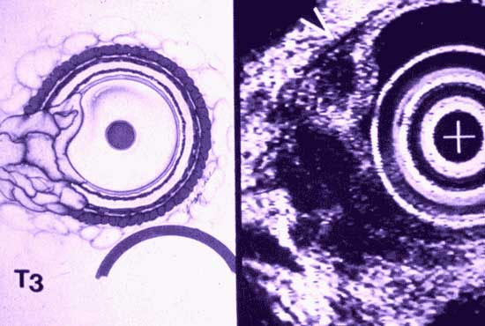
Esophageal T3 Lesion

Slide 24
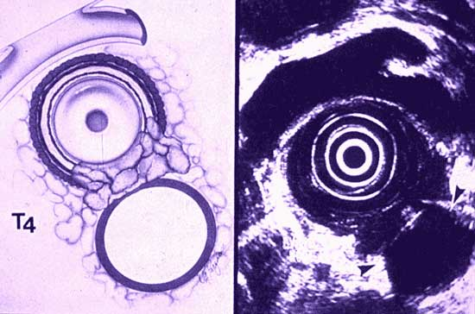
Esophageal T4 Lesion

Slide 25
Tumour Staging: Nodes
Malignant nodes : Large (>1cm)
Homogeneous
Well Circumscribed
Round
If all 4 criteria are met , the specificity is high
FNA greatly increases the specificity

Slide 26
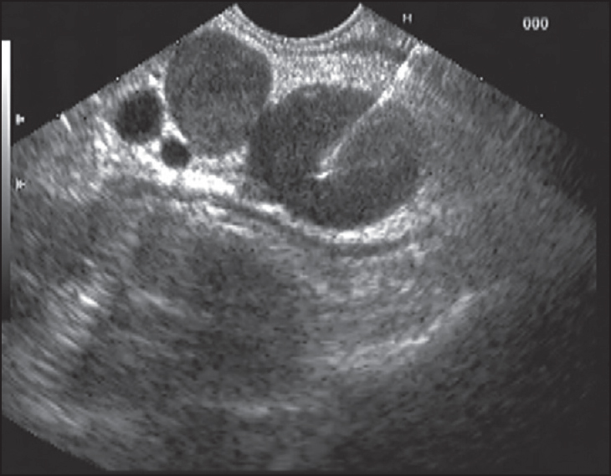
Malignant Lymph Nodes

Slide 27
Upper GI Tract: Benign Lesions
Sub-epithelial lesions:
Thickened Mucosal Folds
Lipomas
Carcinoid tumours
Varices
Pancreatic rests
Stromal lesions
Extrinsic Compression
( Tumours, Pseudocyst, Lymph nodes)

Slide 28
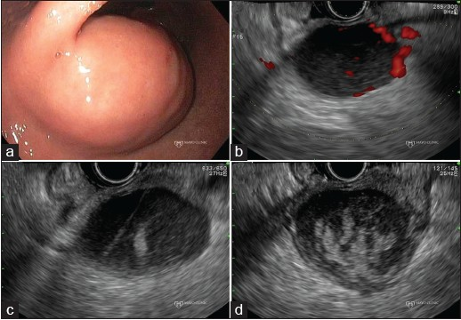
GIST ( Gastrointestinal Stromal Tumour)

Slide 29
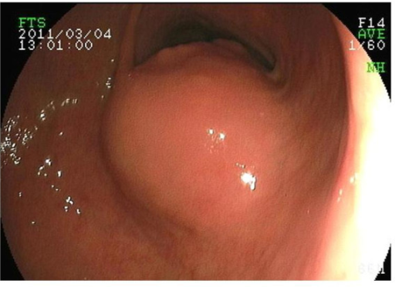
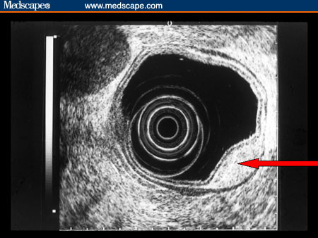
Lipoma

Slide 30
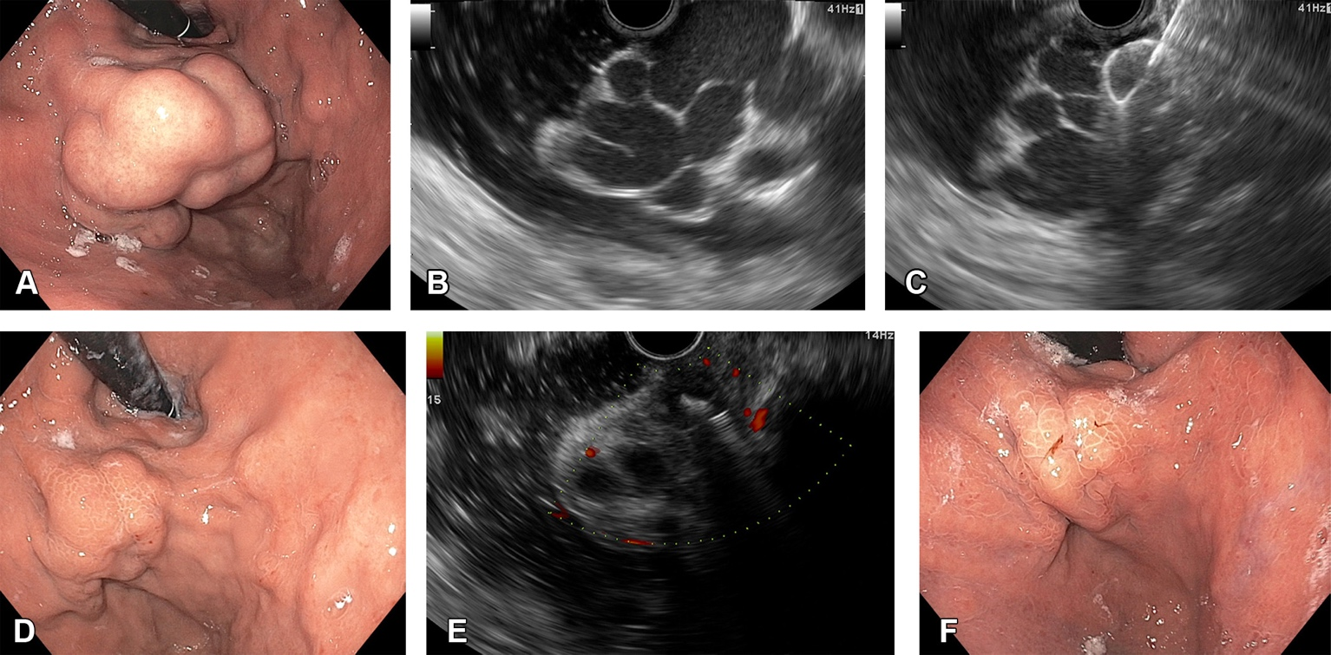
Gastric/Esophageal Varices

Slide 31
Chronic Pancreatitis
Most sensitive radiographic modality for diagnosing chronic pancreatitis
Standard EUS criteria for diagnosing CP
Features include parenchymal calcification, lobulation, dilated tortuous PD

Slide 32
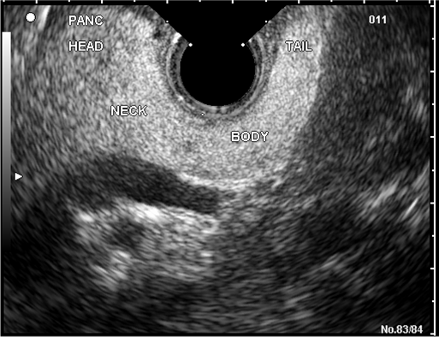
Normal Pancreas

Slide 33
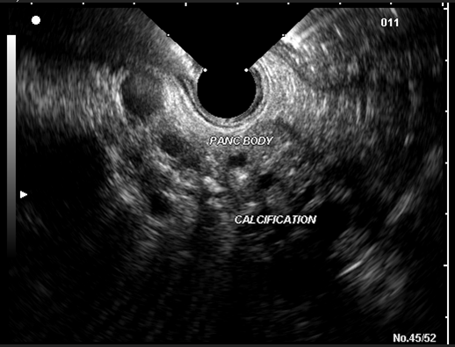
Chronic Pancreatitis

Slide 34
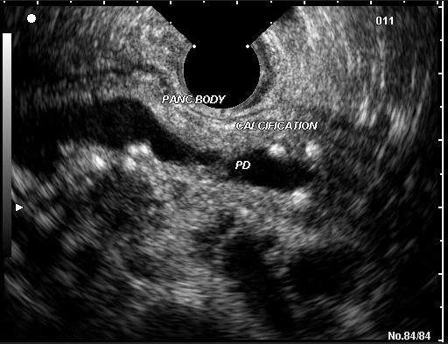

Slide 35
Choledocholithiasis
Most sensitive imaging technique for detecting stones
More sensitive than MRCP
Spatial resolution to 0.1mm ( sludge)
Increasingly used to rule out small stones in CBD

Slide 36
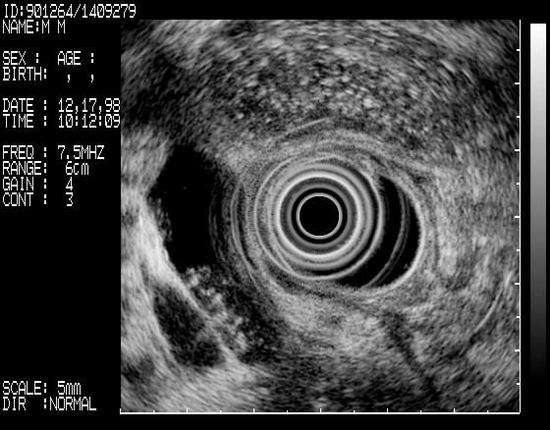

Slide 37
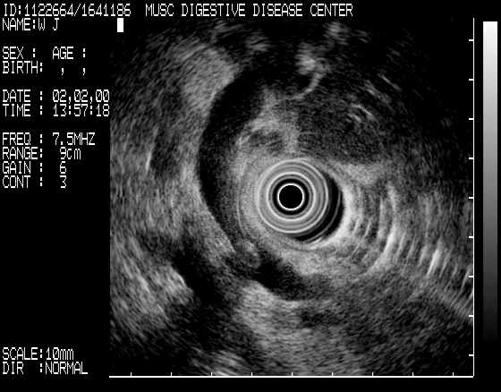

Slide 38
Interventional EUS
EUS guided FNA
Celiac plexus neurolysis for CP or pancreatic cancer pain. Safer approach than traditional posterior fluoroscopically directed approach
Other indications include Drainage of pseudocysts, BOTOX injections for achalasia

Slide 39
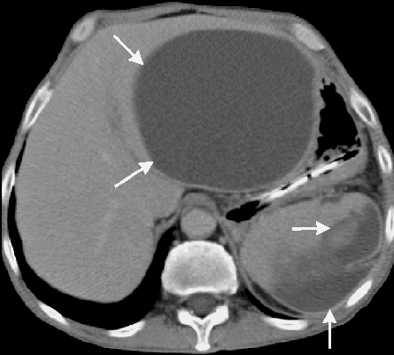
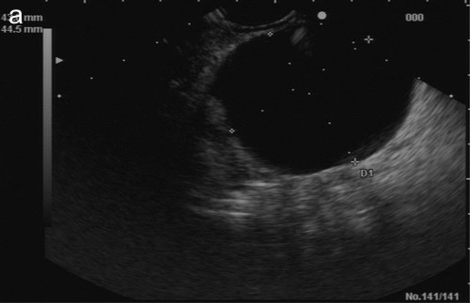
Pancreatic Pseudocyst

Slide 40
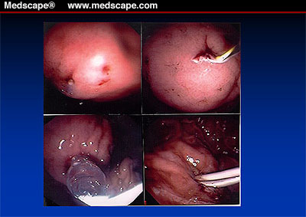
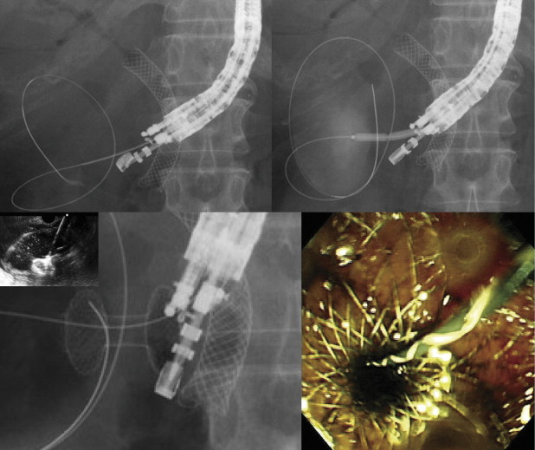
Pseudocyst Drainage (Endoscopic)

Slide 41
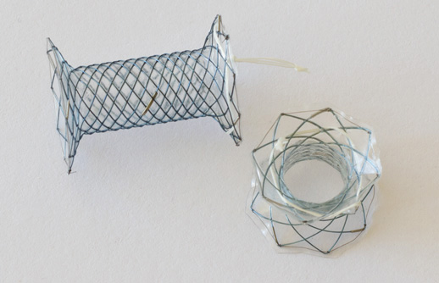
Pseudocyst (Endoscopic Drainage)

Slide 42
Complications of EUS
Oxygen desaturation
Cardiac arrythmias
Perforation
Bleeding ( FNA)
Pancreatitis ( FNA)
Infection ( Local or Systemic)

Slide 43
Antibiotic Prophylaxis
Cyst Aspiration
Rectal Lesion Puncture
Radial EUS exam is a low risk procedure
EUS/FNA should be considered a high risk procedure based on ASGE endocarditis guidelines

Slide 44
Summary
EUS allows for accurate diagnosis of submucosal lesions
Greater accuracy in staging esophageal,gastric, pancreatic/ampullary and rectal carcinoma
Non invasive diagnostic modality for choledocholithiasis and chronic pancreatitis
EUS guide FNA allows for tissue sampling
Therapeutic EUS continues to evolve

Slide 45
