Slide 1
Blood and Guts
Radiology in GI Emergencies
Ian Weir
Radiology, Vancouver Island Health Authority
I have no conflicts to disclose
September 2017

Slide 2
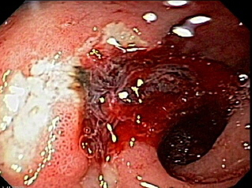

Slide 3
Spectrum of Problems
Perforation
GI bleeding
Ischemic gut
Abscesses
Biliary Obstruction and Leaks

Slide 4
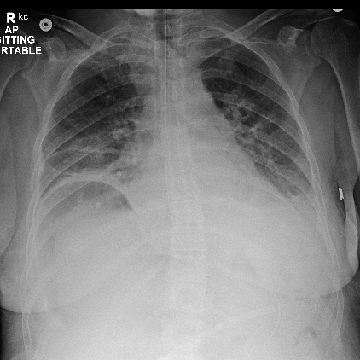
GI Perforation
Ulcer disease most common
Diverticular rupture
Trauma
Iatrogenic
Mortality up to 30-50%!
Free Air under Diaphragm

Slide 5
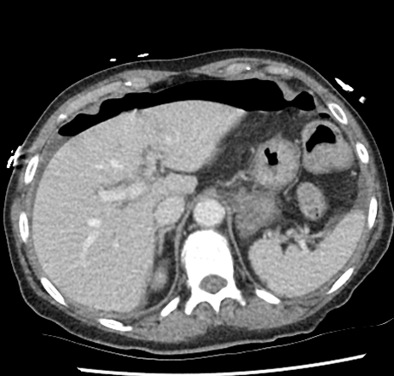
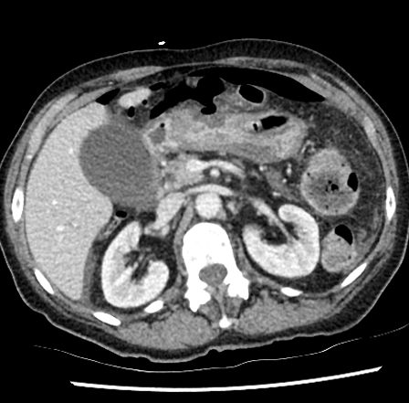
GI Perforation
CT often done to look for site of perf, abscess or other complications
Free Air
Huge gastric ulcer

Slide 6
Ischemic Bowel
Common in elderly, vasculopathic patients
Diabetic, renal failure, smokers
Present with chronic pain, weight loss, pain worse with eating
“Fear of food”, because get intestinal angina after eating
Also acute pain if acute embolic occlusion or thrombosis of pre-existing stenosis

Slide 7
Ischemic Small Bowel
Very high mortality rate - >50%
Often challenging to recognize, need to think about it when no other good explanation for severe pain
Need urgent treatment to avoid infarction of small bowel

Slide 8
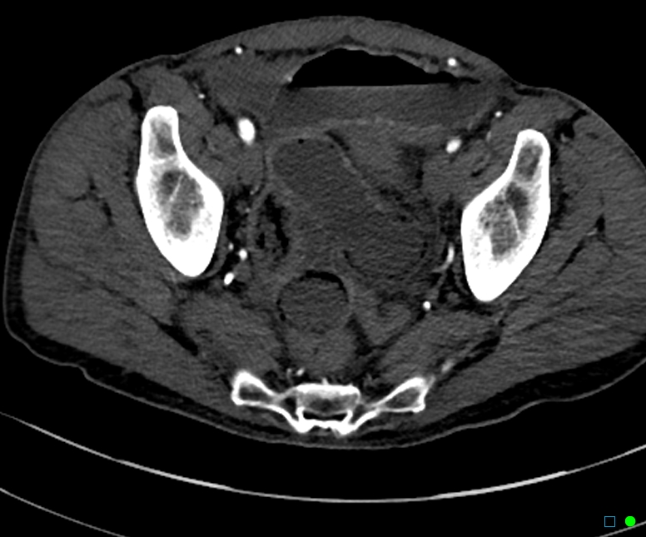
Abdominal Pain
Subtle air in bowel wall, lack of enhancement

Slide 9
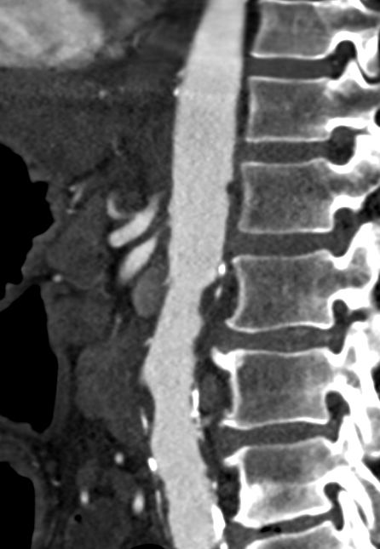
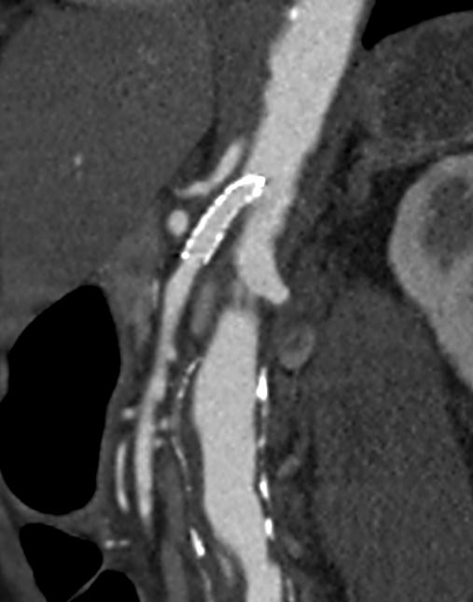
Tight Celiac & SMA stenoses
SMA Stent

Slide 10
Angioplasty and Stenting of Mesenteric Ischemia
Much less invasive than surgical bypass
May allow limited or no resection of ischemic bowel
Done urgently to temporize, stabilize patient
Often still need laparotomy but better chance of not needing extensive resection
Prior patient had just a short segment of gut removed

Slide 11
Ischemic gut – a less happy ending
Abdo pain, diarrhea for a month
Worse after a meal of “bad Chinese food”
Initial CT non- specific
Repeat CT after increasing pain, tachycardia and atrial flutter

Slide 12
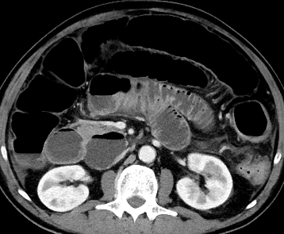
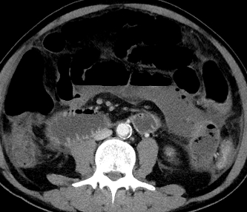
Embolic SMA Occlusion
Enhancing, dilated proximal jejunem
Enhancing SMA, SMV
No enhancement of gut,
or SMA/SMV

Slide 13
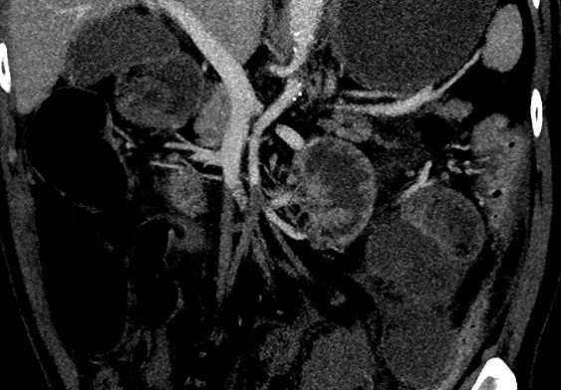
Occluded SMA, no venous return from SMV
SMA Occlusion
SMV
All but 45 cm of small bowel and distal half of colon infarcted, Home TPN started

Slide 14
GI Bleeding
Common problem
40-150 episodes/100,000/year UGI
20-27/100,000/year LGI
70% older than 65 years of age
Mortality can be considerable, highest for variceal hemorrhage (up to 40%)

Slide 15
GI Bleeding
70-75% UGI, 25-30% LGI
70-75% stop spontaneously
Minority need emergent treatment
Most don’t need radiology

Slide 16
GI Bleeding
UGI – esophagus, stomach and duodenum, proximal to ligament of Treitz
  Hematemesis, melena
LGI – distal to ligament of Treitz – jejunum, ileum and colon
  Hematochezia
UGI may present with hematochezia if brisk

Slide 17
Causes of UGI Bleeding
Gastroduodenal erosions/ulcers 55-74%
Variceal bleeding 5-14%
Mallory-Weiss tear 2-7%
Vascular lesions 2-3%
Neoplasms 2-5%

Slide 18
Causes of LGI Bleeding
Diverticular Disease 20-55%
Angiodysplasia 3-40%
Neoplasms 2-26%
Colitis 6-22%
Benign Anorectal lesions 9-10%

Slide 19
GI Bleeding
Initial assessment and resuscitation
Decide if likely UGI or LGI
Endoscopy is generally the initial diagnostic (and therapeutic) procedure for both UGI and LGI bleeds

Slide 20
When to turn to Radiology
If endoscopy does not reveal the bleeding source
If endoscopic treatment is not successful

Slide 21
What can Radiology Offer?
Diagnostic studies
  Scintigraphy
  CT Angiography
  Angiography
Therapeutic procedures
  Embolization
  TIPS (Transjugular intrahepatic portosystemic shunt)
  BRTO (Balloon assisted retrograde transvenous obliteration of varices)

Slide 22
Diagnostic Radiology
Need to be actively bleeding at time of study for most GI bleeds
Rarely see vascular masses (if in small bowel, missed by endoscopy) without extravasation
Angiodysplasia may show abnormal vessels, but in absence of extravasation cannot be certain that is cause of bleed

Slide 23
Scintigraphy
Inject labelled RBCs, repetitively image over time
If bleeding will see accumulation of tracer in gut
Can detect very low rates of bleeding (0.1 ml/min), image over time so also better at detecting intermittent bleeding
Lower resolution so localization may be difficult

Slide 24
Scintigraphy
If bleed between imaging cycles, may have peristalsis, either forward or back, so tracer may move from bleeding site

Slide 25
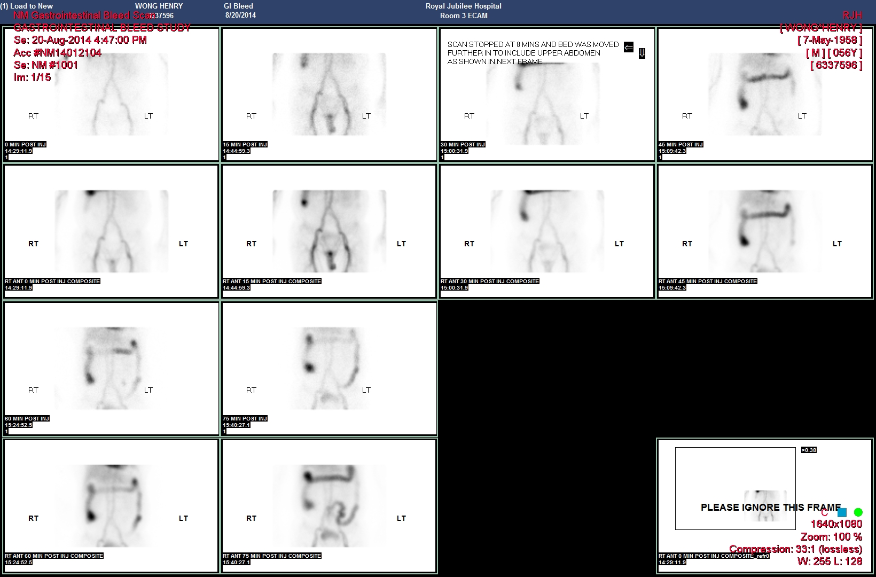
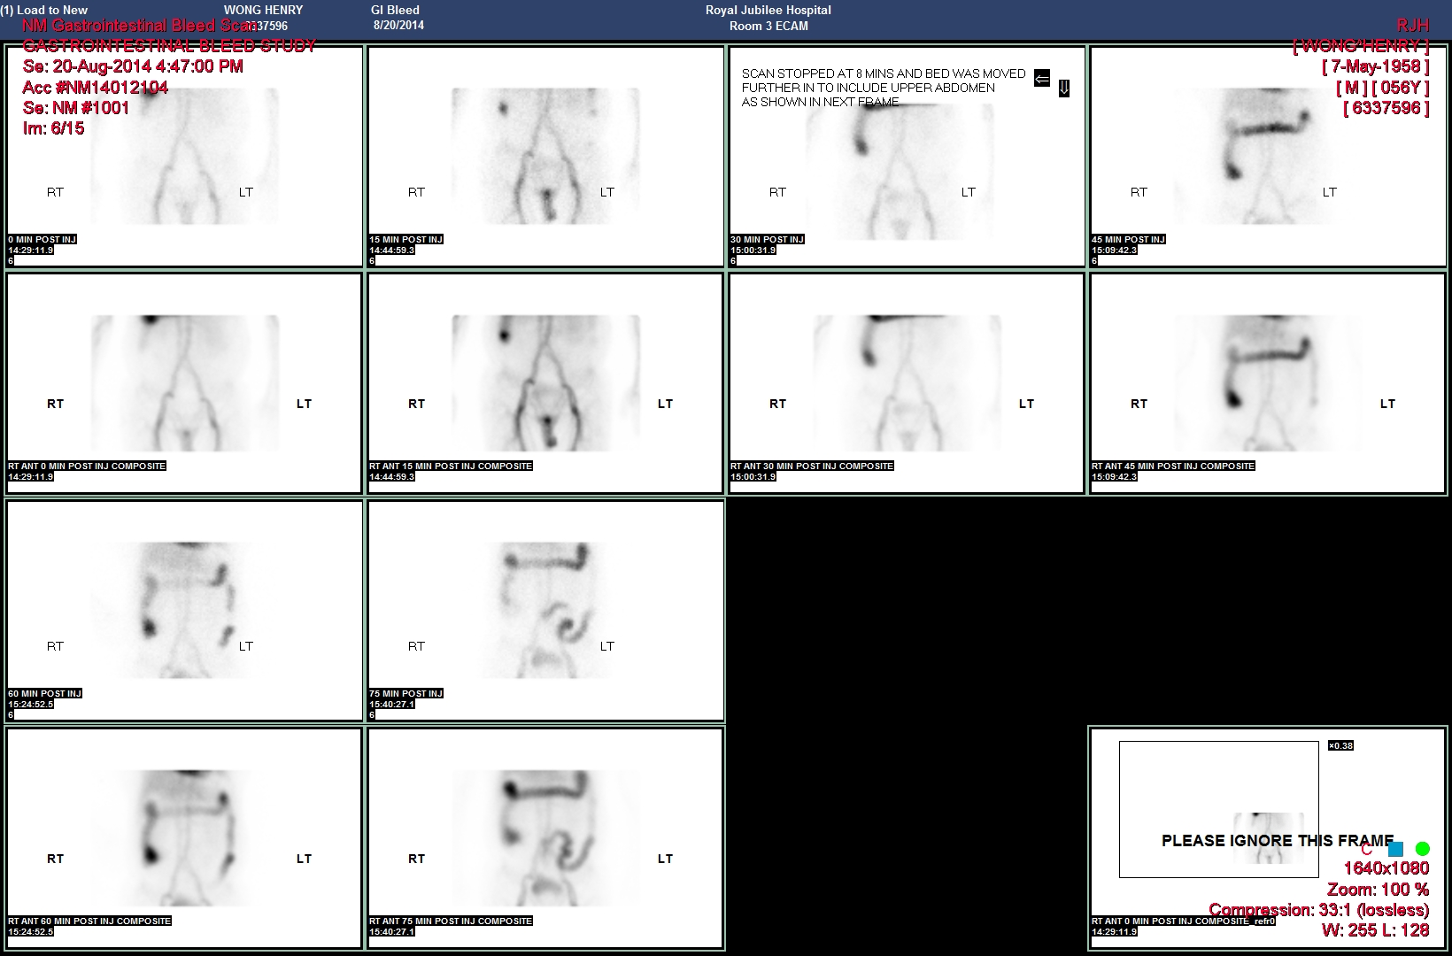
Colonic bleed - scintigraphy

Slide 26
Meckel’s Scans
Meckel’s Diverticulum may cause GI bleeding, especially in younger patients
Rule of 2 – 2% of population
  2 feet from ileocecal valve
  2 inches long
  2% symptomatic
  2 types of ectopic mucosa (gastric and pancreatic) in 2/3 of cases
Those with gastric mucosa ulcerate & bleed

Slide 27
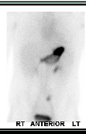
Meckel’s
Uptake in
Gastric Mucosa
There is no stomach
down here!

Slide 28
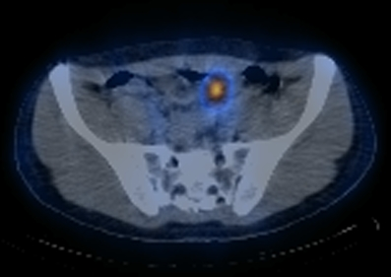
Meckel’s

Slide 29
Angiography
Was the next test after scintigraphy for years
If unstable patient, obvious rapid bleeding, often the first line test
Invasive, costly, time consuming
Now CT Angiography has become commonest test
If CTA does not show bleed, angiography usually not helpful

Slide 30
CT Angiography
Multidetector scanners and increasing computing power has allowed isotropic imaging
Allows rapid imaging with exquisite detail
Can isolate arterial anatomy, then do venous imaging phase as well

Slide 31
CT circa 1972
Pixel size 3 mm
Aperture only allowed head scans
A single slice took 4 minutes, was at least 8 mm thick
7 minutes per slice to reconstruct
Hounsfield and Cormack shared the Nobel Prize

Slide 32
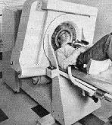
CT circa 1972

Slide 33

CT circa 1972

Slide 34
CT circa 2017
MDCT – up to 320 slices at once, in less than one second
Can image up to 45 cm in one rotation
Pixel size down to 0.3 mm
Able to freeze motion, depict tiny structures accurately

Slide 35
Can CT depict GI Bleeding?
Reported over 80% accurate
May depict active bleeding
May depict abnormalities associated with bleeding (neoplasms, IBD, aorto-enteric fistula, varices or vascular lesions, diverticular disease)

Slide 36
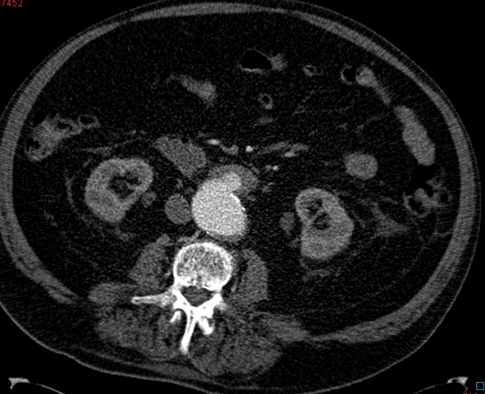
Aorto-enteric fistula

Slide 37
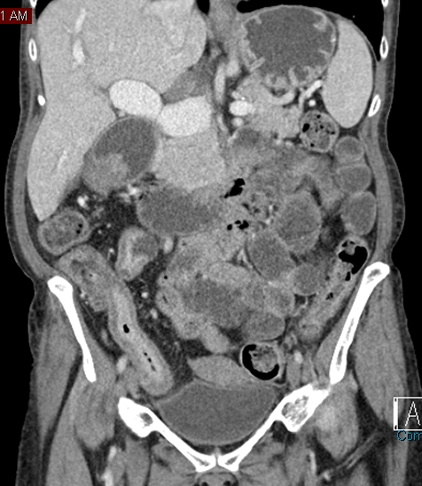
Crohn’s Disease, Terminal Ileum

Slide 38
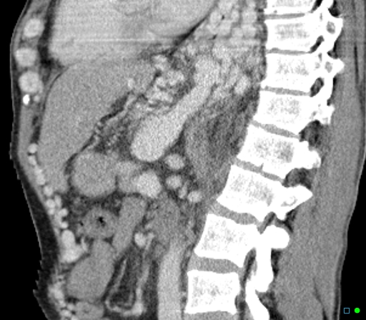
Massive Varices
GE Junction
Caput Medusa

Slide 39
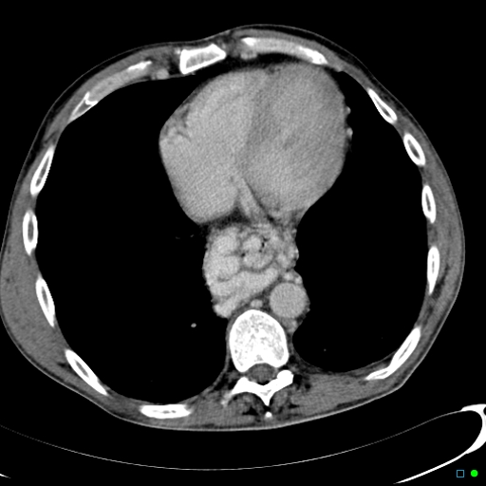

Slide 40
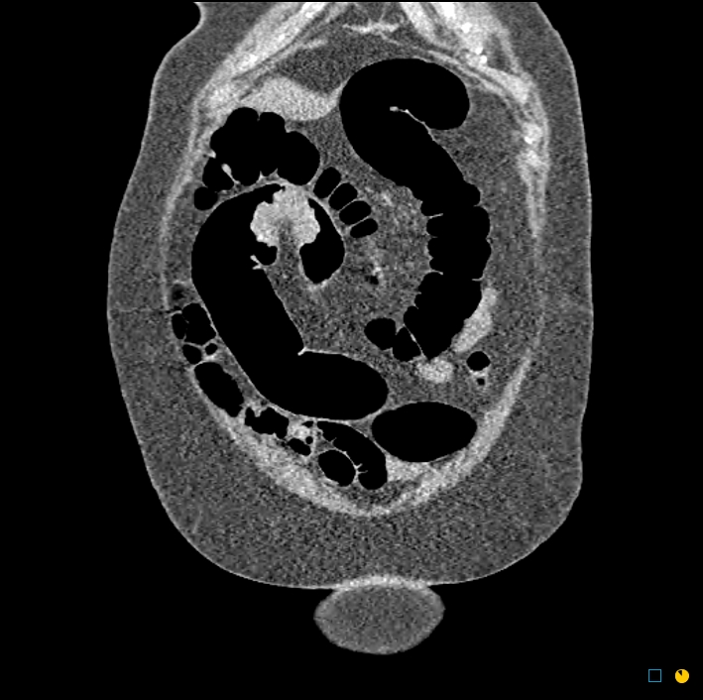
CT Colonography
Colon Cancer

Slide 41
What about active bleeding on CT?
Ideally have non-contrast, arterial and delayed images
Able to see contrast extravasation as focal high attenuation, not seen on NC images, changing configuration over time in venous phase
Oral contrast, old barium, ingested material can cause confusion

Slide 42
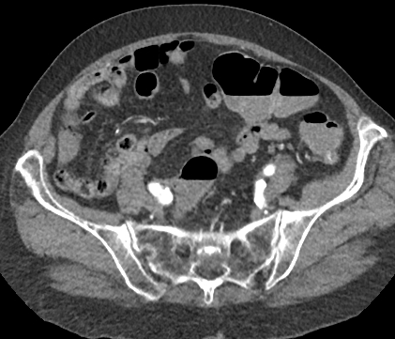
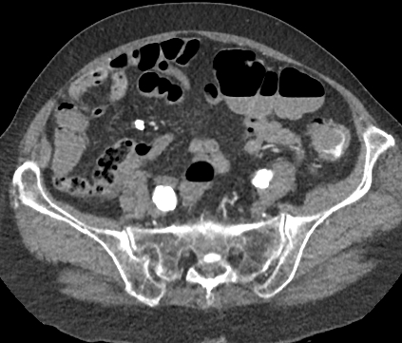
Diverticular Bleed
Subtle contrast in diverticulum
Contrast pooling in bowel lumen

Slide 43
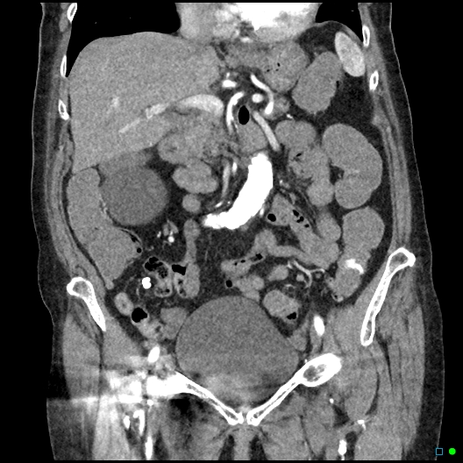
Diverticular Bleed
Contrast extravasation

Slide 44
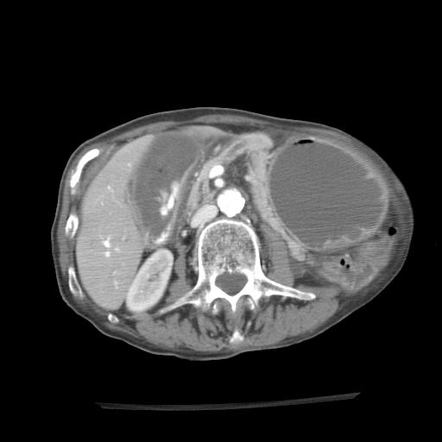
Active Extravasation in Duodenum
Active bleeding

Slide 45
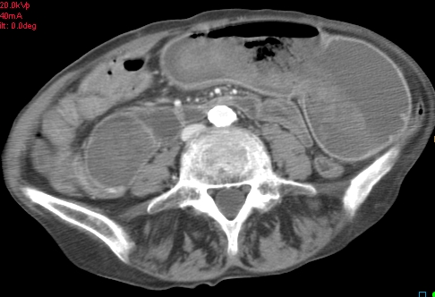
Hyperdense clot in stomach
Clotted blood

Slide 46
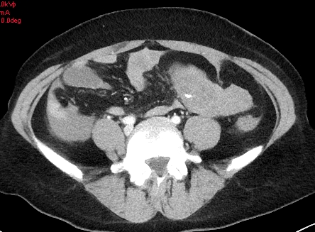
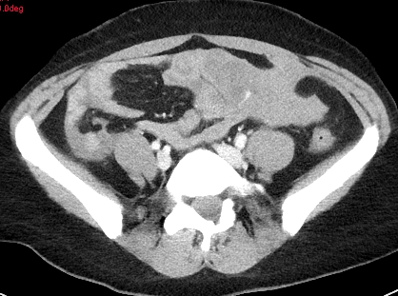
LGI Bleed Post-op Laparoscopy
Active extravasation from trocar injury to jejunem

Slide 47
OK, but we already knew they were bleeding…
Once site is localized, hopefully can block off bleeding vessel for arterial bleeds
In case of variceal bleeding, can reduce portal pressure (TIPS), and/or occlude varices (coils, BRTO)

Slide 48
Embolization Tools
Micro-catheters
Micro-coils
Particles
Gelfoam
Glue

Slide 49
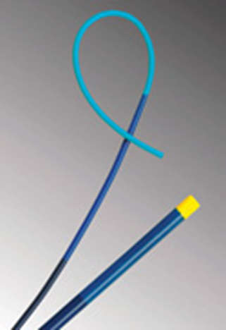
Coaxial 3 Fr
Catheter
1 mm diameter
Fibered Coils
6 Fr. catheter

Slide 50
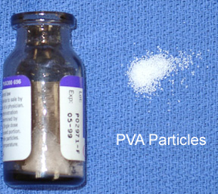
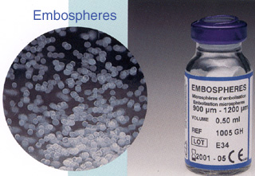
Embolization Particles
Calibrated microspheres
PVA Particles

Slide 51
Gelfoam

Slide 52
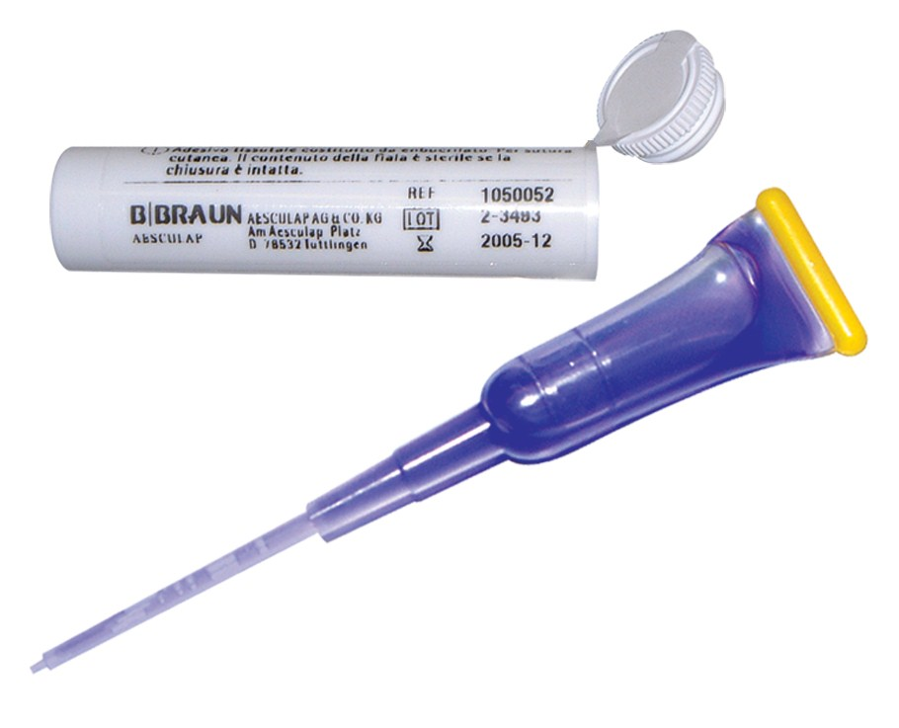
Histoacryl Glue – mix with lipiodol for opacity

Slide 53
Upper GI bleed
73 y.o. male
Melena, pale and weak
Duodenal bleed seen endoscopically
Unable to control with adrenaline/saline injection
COPD

Slide 54
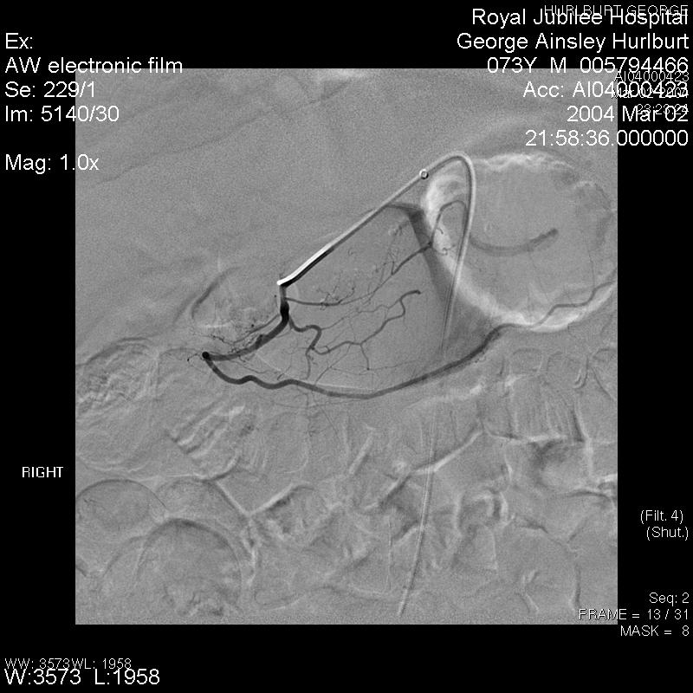

Slide 55
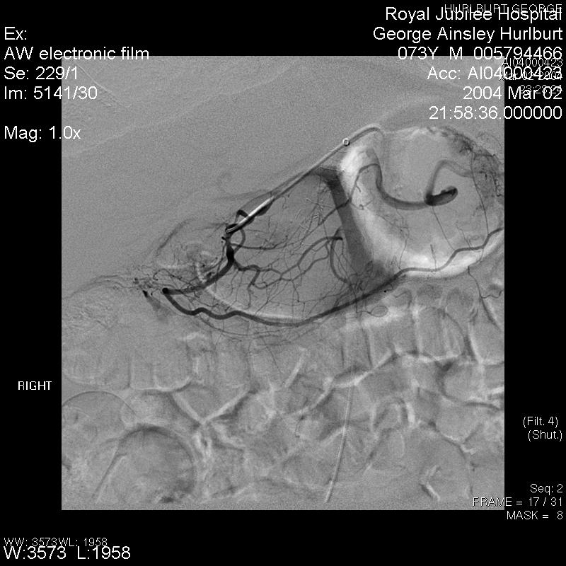

Slide 56
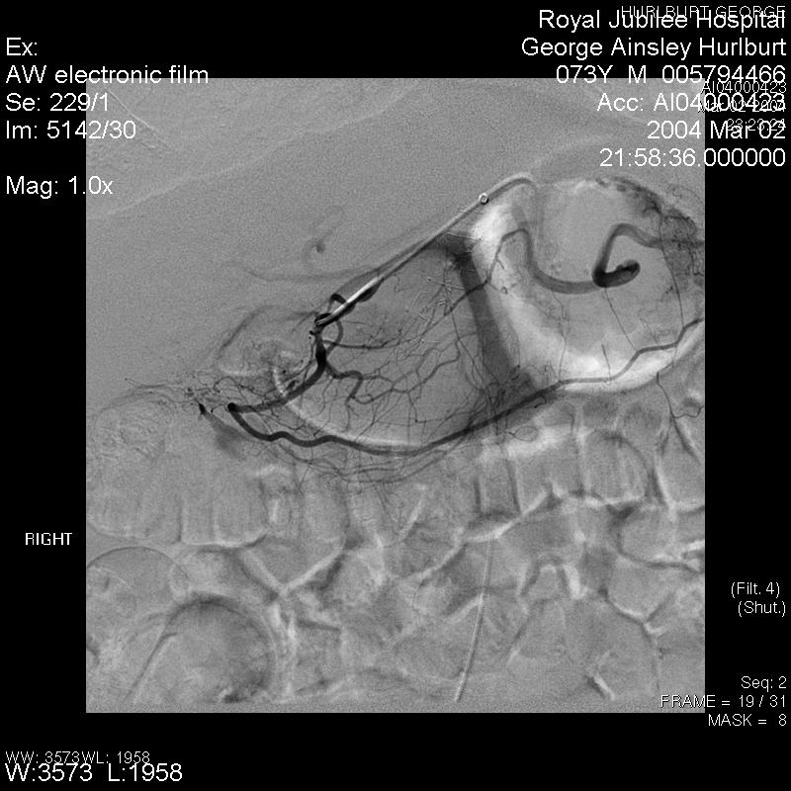

Slide 57
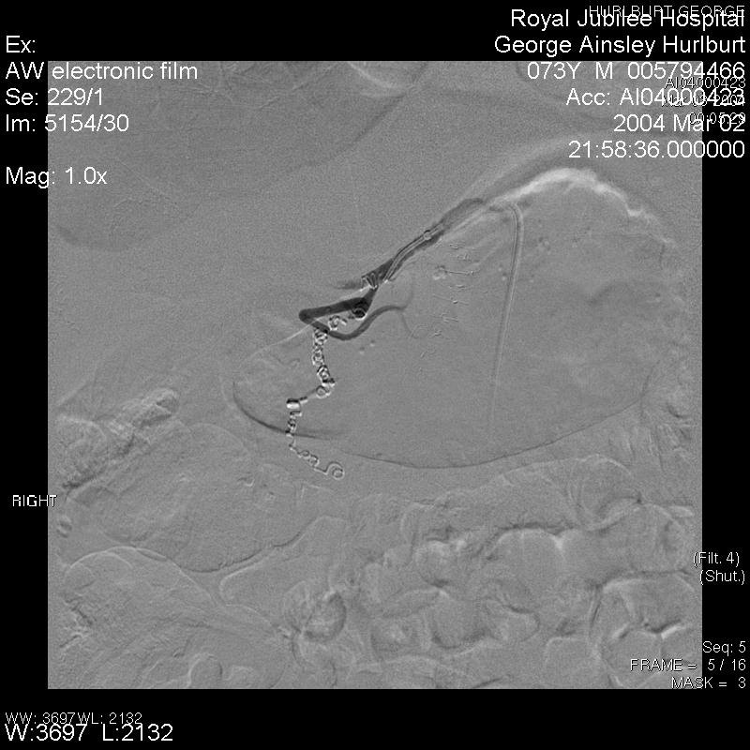

Slide 58
UGI Bleed - Case 2
83 year old woman
Melena for 3 days
Hemoglobin 32, Hematocrit 0.10
COPD, ETOH abuse
CT shows active extravasation
Endoscopy with adrenalin and clips, rebled

Slide 59
UGI BLEED
Duodenal extravasation

Slide 60
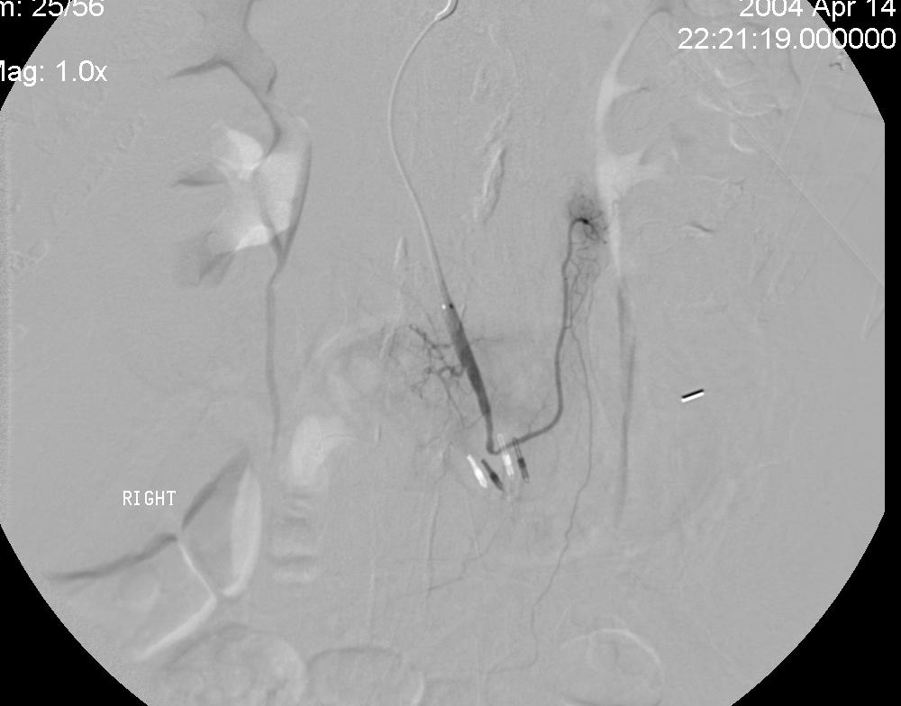
Micro-catheter in GDA
Clips localize site of bleed

Slide 61
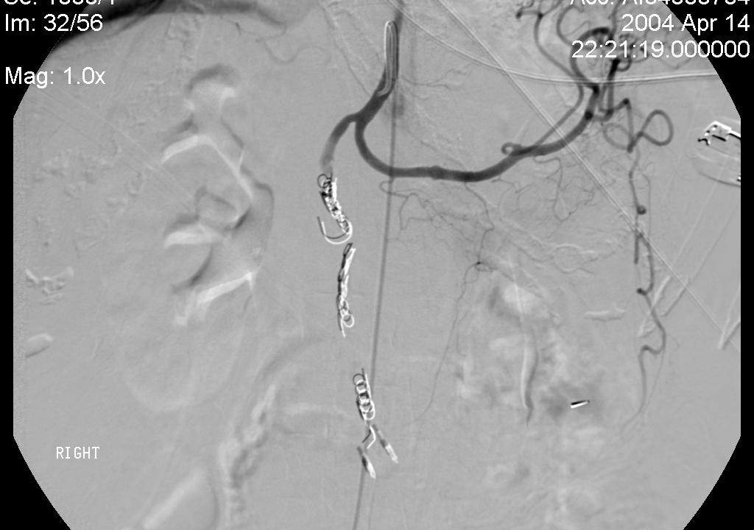
GDA Occluded by Coils

Slide 62
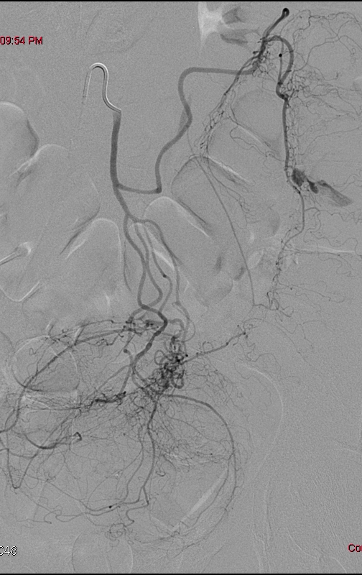
Lower GI Bleed
Inferior Mesenteric
artery injection
Bleed

Slide 63
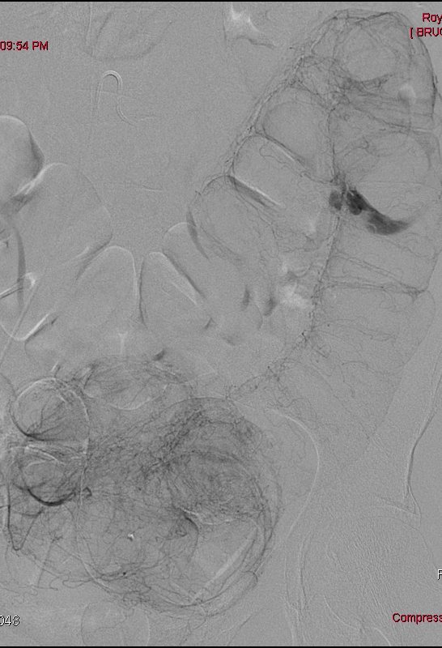

Slide 64
Can we get a
catheter to there?

Slide 65
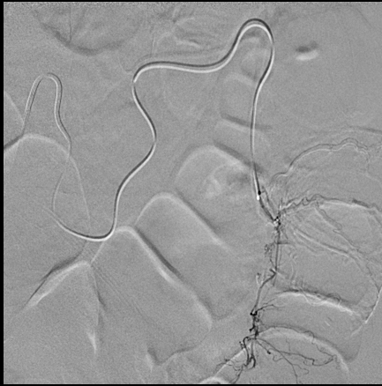
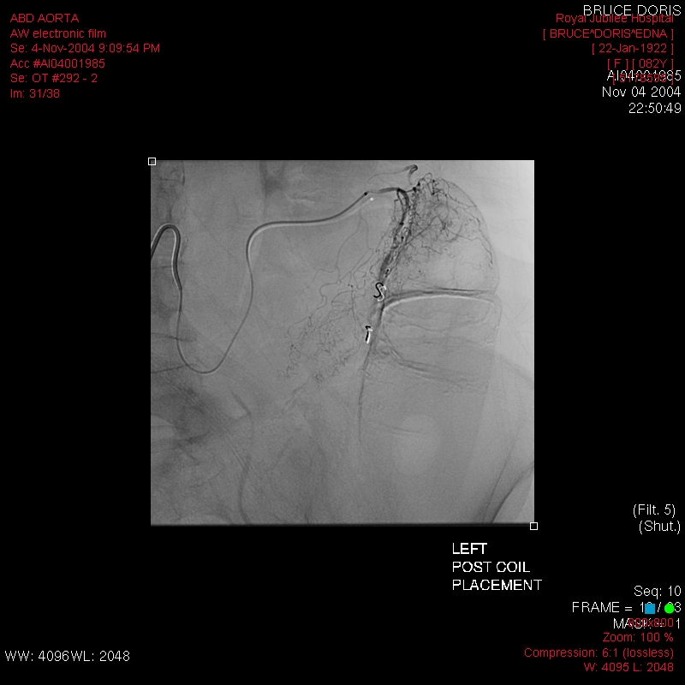
Micro-catheter and Coils
2 coils placed

Slide 66
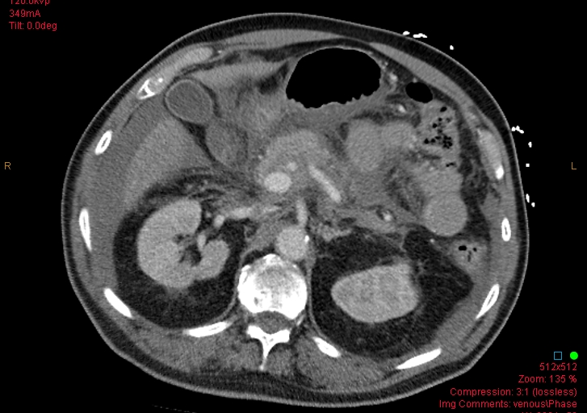
Acute Pancreatitis

Slide 67
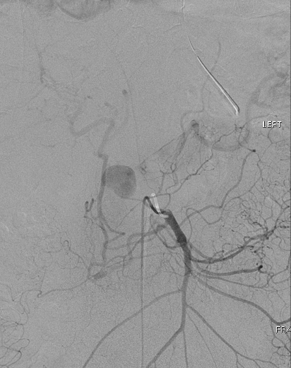
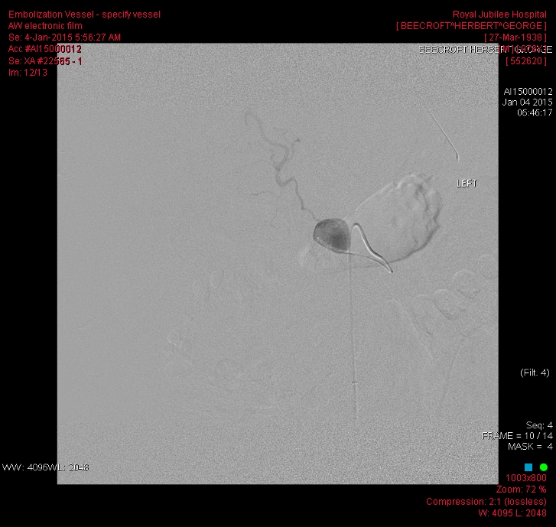
Micro-catheter into false aneurysm

Slide 68
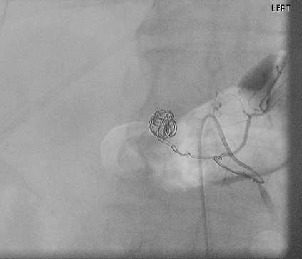
Coils pack aneurysm and feeding vessel

Slide 69
Difficult LGI Bleed
Vasculopath with prior AAA repair, bilateral AK Amputations, massive rectal bleed, in ICU – sent for CTA

Slide 70
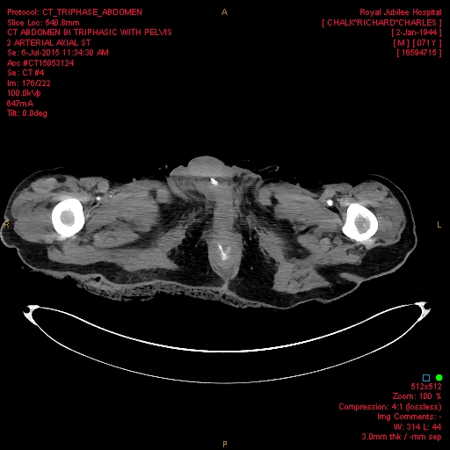
CTA Findings:
Extravasation
Occluded IMA, occluded left internal iliac, aneurysm of right common and internal iliac, tight stenosis of origin of middle hemorrhoidal artery (bleeding vessel), active bleeding

Slide 71
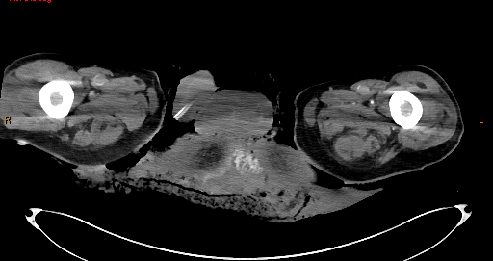
Contrast Extravasation into diaper!

Slide 72
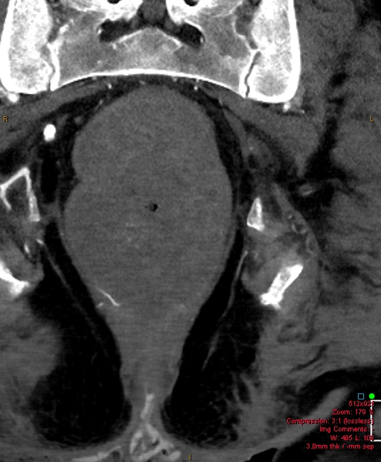
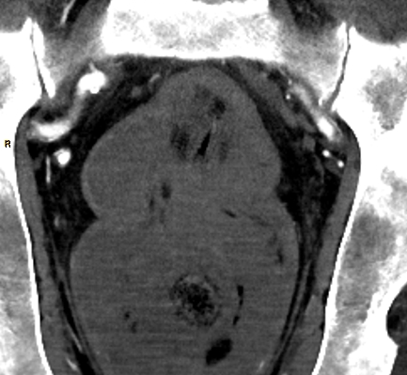
Tight stenosis at origin,
unlikely to get into it
Bleeding artery
Endoscopically clipped instead

Slide 73
Portal Hypertension
Variceal Bleeding has a very high mortality rate
Large drain on blood bank
May be massive and dramatic, or slower but recalcitrant to treatment
Usually treated with medical management, endoscopic sclerotherapy/banding
If that fails, TIPS is next option

Slide 74
TIPS
Transjugular Intrahepatic Portosystemic Shunt
Cannulate hepatic vein, place long needle down sheath and puncture liver parenchyma to get into portal vein branch
Dilate and stent tract, creating a shunt from portal vein to hepatic vein – percutaneous creation of a porto-caval shunt

Slide 75
TIPS
Diversion of portal flow past diseased liver
Lessens portal pressure, so less variceal bleeding, less ascites production
Similar to sclerotherapy, diminishes drain on blood bank
Does not treat underlying disease, so no improvement in overall mortality
Bridge to transplant for some

Slide 76
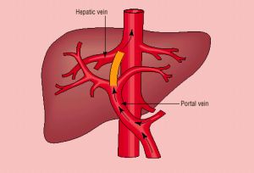

Slide 77

TIPS in three easy steps
#1 – locate right hepatic vein

Slide 78

TIPS in three easy steps
#2 – puncture into portal vein branch

Slide 79


TIPS in three easy steps
#3 – place stent across tract, dilate it

Slide 80

TIPS
Cirrhosis, recurrent GI bleeds, ICU admissions

Slide 81


TIPS shunt with persistent varices
Para-esophageal
varices still fill
Left gastric
(coronary) Vein
Stent

Slide 82


Occlude varices with coils, plugs, sclerosants
No more variceal filling, antegrade flow thru shunt
Coils
Vascular Plug

Slide 83
Blood and Guts
Part Two
Maybe another time
Thank you for your attention!
Questions???

