Slide 1
Three Patients, Three Diseases
JP McGhie
23 Sept 2017

Slide 2
Disclosures
I have received speaker’s honoraria from the following companies: Amgen, Astra-Zeneca, Bayer, Celgene, Ipsen, Roche
I am a clinical trial investigator and some of these trials have been industry sponsored
Each year I request funds from multiple industry partners to sponsor the Vancouver Island Oncology Conference (VIONC)

Slide 3
Outline
We’ll meet three patients with three diagnoses
Explore:
The Diversity of the GI tract
The Diversity of the Diseases
The Diversity of Choices for Patients
Let’s meet our patients!

Slide 4
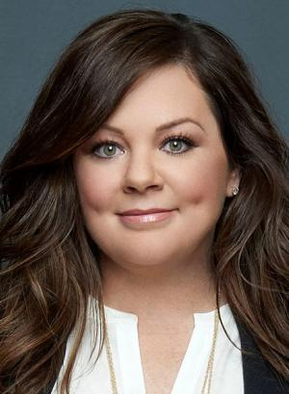
Ginny
47F, colon cancer
Adenocarcinoma of the right colon, T3 N1

Slide 5
Vinnie
59M, with metastatic pancreas cancer
Liver and lung metastases

Slide 6
Winnie
63F, metastatic NET
Neuroendocrine tumour of the small bowel, with liver metastases

Slide 7
The Medical Oncology Approach: and the Server Analogy
Establish Rapport
Discuss the Menu
Make Your Recommendation
Quality Check

Slide 8
Ginny
47F, colon cancer
Adenocarcinoma of the right colon, T3 N1

Slide 9
Diagnosis
Change in bowel habit

Slide 10
Bloodwork
HGB 89
MCV 72

Slide 11
Diagnosis
Change in bowel habit
Endoscopy

Slide 12
Diagnosis
Change in bowel habit
Endoscopy
The metastatic work-up

Slide 13
Diagnosis
Change in bowel habit
Endoscopy
The metastatic work-up
Pathology report

Slide 14
Staging
T3 N1
T Stage | N Stage
T1- mucosa | N0 (no nodes)
T2- muscle | N1 (1-3 nodes)
T3- wrapping | N2 (4 or more)
T4- outside

Slide 15
Oncology Consultation
Resection doesn’t always equal cure

Slide 16
Oncology Consultation
Resection doesn’t always equal cure
Do I have any risk factors?

Slide 17
Oncology Consultation
Resection doesn’t always equal cure
Do I have any risk factors?
How does my family history fit in?

Slide 19
Oncology Consultation
Resection doesn’t always equal cure
Do I have any risk factors?
How does my family history fit in?
Why me?

Slide 20
Treatment Choices
Risk of recurrence is the starting point

Slide 21
Treatment Choices
Risk of recurrence is the starting point
One drug or two?
You “pay” for each treatment (in risk)

Slide 22
Treatment Choices: when are these options not available?
Unwell
?Elderly
Late referrals

Slide 23
Follow Up
Surveillance can save your life

Slide 24
Metastectomy

Slide 25
Follow Up
Surveillance can save your life
Cooperation is essential

Slide 26
Follow Up
Surveillance can save your life
Cooperation is essential
The psychology of “the survivor”

Slide 29
My new snack is just a few ounces of tree nuts

Slide 30
Everyone hears this now….

Slide 31
It worked for patients with metastatic disease: with no downside

Slide 32
Outcome
Her story…

Slide 33
Vinnie
59M, with metastatic pancreas cancer
Liver and lung metastases

Slide 34
Diagnosis
Unwell in so many ways…

Slide 35
Diagnosis
Unwell in so many ways…
The Five Symptoms

Slide 36
Diagnosis
Unwell in so many ways…
The Five Symptoms
List of potential symptoms (this a systemic disease)

Slide 37
Diagnosis
Unwell in so many ways…
The Five Symptoms
List of potential symptoms (this a systemic disease)
Many symptoms, many victims

Slide 38
RIP

Slide 39
RIP

Slide 40
RIP

Slide 41
RIP

Slide 42
RIP

Slide 43
RIP

Slide 44
Consultation
“Is this genetic?”

Slide 46
Treatment Choices
My menu

Slide 47
Chemotherapy
Single agent gemcitabine
Mild!

Slide 48
Gemcitabine plus something…
Gemcitabine + Erlotinib
Useless!

Slide 49
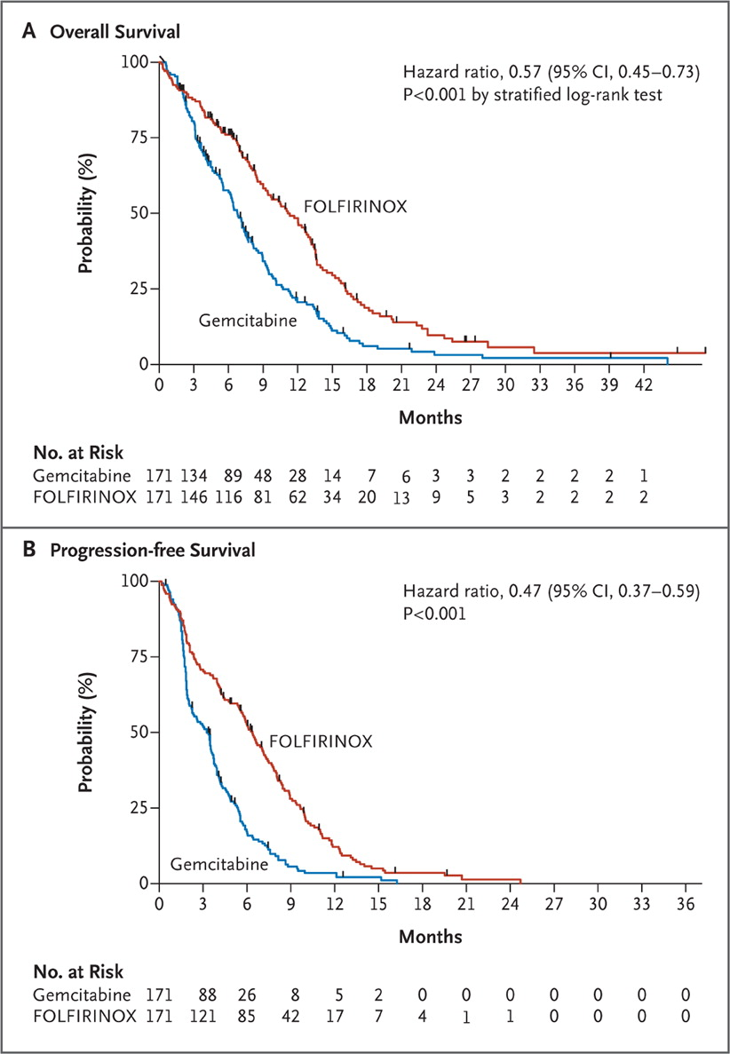
FOLFIRINOX
Toxic!
Conroy T et al. NEJM 2011;364:1817-1825.

Slide 50
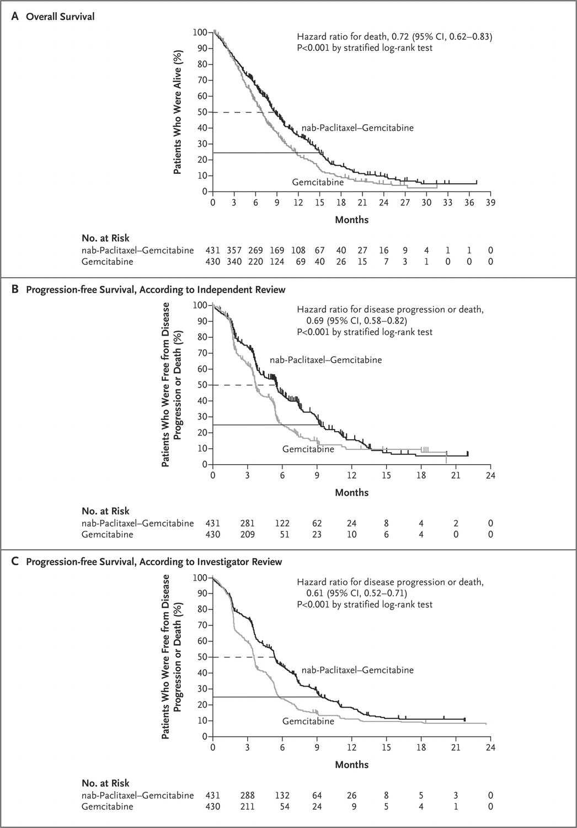
Gem / Nab-Paclitaxel
Von Hoff DD et al. NEJM 2013;369:1691-1703.

Slide 51
An approach…
ECOG 1
<65
ECOG 2
ECOG 3
Folfirinox
Gem/Abraxane
Gem
BSC

Slide 52
Palliative Care
Palliative care is key!

Slide 53
MAiD adds a new twist
Medical Assistance in Dying

Slide 54
Outcome
His choices…

Slide 55
Winnie
71F, metastatic NET
Neuroendocrine tumour of the small bowel, with liver metastases

Slide 56
Diagnosis
Annoying stomach, burpy, farty…abdo pain

Slide 57
Same old story…

Slide 58
Diagnosis
Annoying stomach, burpy, farty…
Certain foods make me feel yucky…

Slide 59
Diet change helped!

Slide 60
Diagnosis
Annoying stomach, burpy, farty…
Certain foods make me feel yucky
How to identify the zebra among the hoof beats

Slide 62
Oncology Consultation
What took you so long?

Slide 63
Oncology Consultation
What took you so long?
How do we fix this?

Slide 64
Oncology Consultation
What took you so long?
How do we fix this?
I need better advice!

Slide 66
Oncology Consultation
What took you so long?
How do we fix this?
I need better advice
I hate this situation

Slide 67
The situation…

Slide 68
Carcinoid Syndrome

Slide 69
Treatment Choices
Here and now
Somatostatin Analogues

Slide 70
Treatment Choices
Here and now
The big picture

Slide 71
Treatment Choices
Here and now
The big picture
What about immunotherapy?

Slide 72
However most NETs don’t express PD-1

Slide 73
Follow Up Appointments
The evolution of disease/patient/illness

Slide 74
Let’s grow old together…

Slide 75
Follow Up Appointments
The evolution of disease/patient/illness
Why we “love” (and “hate”) managing these patients

Slide 76
Why managing patients with NETs is so easy…and so difficult
Easy
Difficult
Long history with patients
Very little evidence
Knowledgeable patients
Never boring
Long history with patients
Very little evidence
Knowledgeable patients
Never boring

Slide 77
Outcome
How is she today?

Slide 78
Still going strong…
Carcinoid syndrome controlled by somatostatin analogue monthly injections (lanreotide)
Disease slowly progresses
Continues to exercise
Has passed the 7 year mark with her disease!

Slide 79
What have we learned from Three Diseases?
CRC: curative, adjuvant therapy can help
Pancreas cancer: lethal, systemic disease
NETs: weird, keep suspicion high to recognize them

Slide 80
What have we learned from Three Patients?
We all have different priorities
We are all concerned about different things
As diseases and individuals vary, so do outcomes

Slide 81
Live long and prosper
Thank you!!

