Slide 1
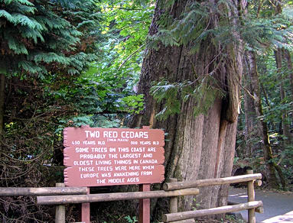




The Sweet Talk
CSGNA, Victoria BC,21 Sept 2017
DR DAVID MILLER MD FRCPC Cert Endo Cert Epi

Slide 2
OUTLINE
Drugs for diabetes – and the list just keeps getting longer
Insulin
• Life saving therapy for patients with type 1 and other insulinopenic diabetes
• Life sustaining for some patients with type 2 diabetes
Non-insulin drugs for diabetes
• And there are a whole lot of new ones!
Prepping the diabetic patient for a GI procedure
Cool stuff: new diabetes technologies

Slide 3
LEARNING OBJECTIVES
Understand insulin and (new) insulin kinetics
Learn mechanism of action and role for (new) diabetes medications
Learn how to (safely) prepare your diabetic patient for a GI procedure
New technology – the future is now

Slide 4
Disclosure:
Clinical Research Funding:
Boehringer Ingelheim, Sanofi-Aventis
Speakers Fees:
Eli-Lilly, NovoNordisk, Sanofi-Aventis, Merck, Janssen, Astra-Zeneca
Advisory boards, other financial interests:
Abbott
Today’s presentation:
developed by Dr. Miller at request of meeting organizers
sponsored by Novo-Nordisk, without input into content

Slide 5
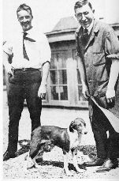

Insulin – a uniquely Canadian invention
Dr. Frederick Banting
(future Dr.) Charles Best
University of Toronto 1921
1923 Nobel Prize for Medicine
Dr. Frederick Banting
Dr. John Macleod

Slide 6
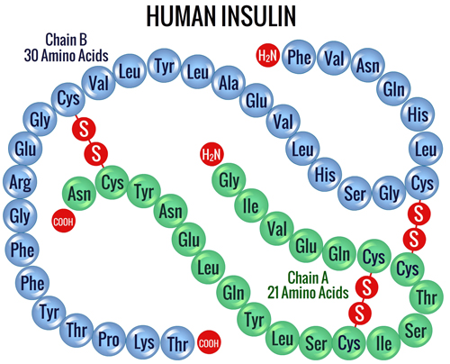

Slide 7
INSULINS MAINLY DIFFER IN WHEN THEY START
AND WHEN THEY FINISH
Rapid-acting analogues (bolus): aspart, glulisine, lispro – 30 min to 3.5 hours
(SC administration)
NovoRapid ®, FiAsp ®, Apidra ®, Humalog ® , Humalog 200 ®
Fast-acting (bolus): regular – 1 hour to 6 hours
Novolin Toronto ®, Humulin R ®
Intermediate-acting (basal): NPH – 2.5 hours to 12 – 15 hours
Novolin NPH ®, Humulin N ®
Long-acting analogues (basal): detemir, glargine – 18-24 hours (detemir), to 24 hours (glargine)
Levemir ®, Lantus ®, Toujeo (glargine 300) ®, Basaglar ®
Premixed: fixed ratio of rapid- or fast-acting and NPH

Slide 8
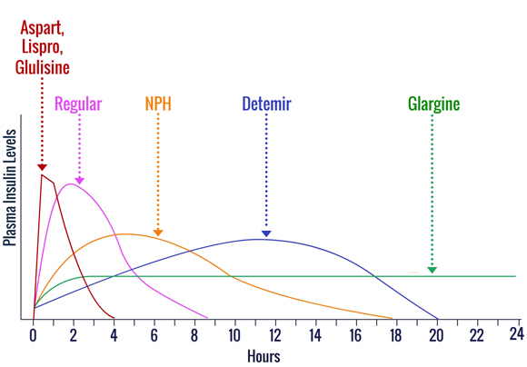

Slide 9
NON-INSULIN DRUGS for DM
Insulin secretagogues
sulfonylureas gliclizide
glimepiride
glyburide
non-sulfonylureas nateglinide
repaglinide
Insulin sensitizers
biguanide metformin
TZD pioglitazone
rosiglitazone
Combinations
Combination products also exist, usually
metformin + another oral medication
Other
α glucosidase inhibitor acarbose
SGLT-2 inhibitors canagliflozin
dapagliflozin
empagliflozin
DPP-IV inhibitors linagliptin
saxagliptin
sitagliptin
GLP-1 analogues albiglutide
(injections) dulaglutide
exenatide
liraglutide

Slide 10



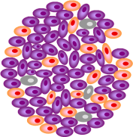
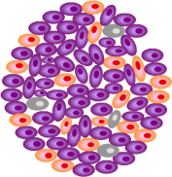
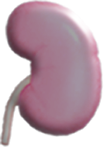
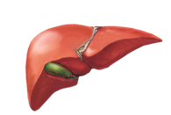
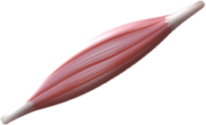
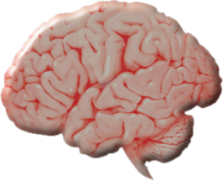
Ominous Octet: Targeting the Core Defects in Type 2 Diabetes with Different Classes of Antihyperglycemic Agents
SU
DPP-4i
GLP-1RA
DPP-4i
GLP-1RA
Islet β–cell
TZD
Decreased
Insulin
Secretion
Decreased
Incretin
Effect
β
Increased
Lipolysis
Islet–α cell
DPP-4i
GLP-1RA
α
Hyperglycemia
Increased
Glucose
Reabsorption
SGLT2i
Increased Glucagon
Secretion
MET
DPP-4i
GLP-1RA
TZD
Neurotransmitter
Dysfunction
Decreased
Glucose Uptake
Increased
Hepatic Glucose
Production
GLP-1RA
TZD
Adapted from DeFronzo RA. Diabetes. 2009;58(4):773-795.

Slide 11
METFORMIN
Pros:
first line pharmacologic therapy for most patients with type 2 diabetes
inexpensive weight neutral as monotherapy
can help reduce weight gain associated with other therapies, including insulin
very low rate of hypoglycemia
improved CV outcomes in overweight (UKPDS)
reduced progression of pre-diabetes to diabetes (DPP)
may reduce cancer risk (indirect evidence only)
also useful in polycystic ovarian syndrome (PCOS)
safe in early pregnancy
Cons:
often has GI side effects – nausea, increase in bowel frequency
contra-indicated if eGFR < 30 mL / min because of risk of lactic acidosis
Dosing:
metformin 250 mg BID to 2500 mg / day, in divided doses
metformin XR 500 mg OD to 2500 mg OD
slow dose escalation can help reduce GI side effects

Slide 12
SULFONYLUREAS
Pros:
long history of use
relatively inexpensive
gliclizide and glimepiride have less hypoglycemia than glyburide
Cons:
potential for weight gain
potential for hypoglycemia
glyburide may increase risk of heart disease (indirect evidence only)
Dosing:
glyburide 2.5 mg OD to 10 mg BID
gliclizide 40 mg OD to 160 mg BID
gliclizide MR 30 mg OD to 120 mg OD
glimepiride 1 mg OD to 8 mg OD

Slide 13
ALPHA GLUCOSIDASE INHIBITOR
Pros:
no weight gain
low risk of hypoglycemia
can help control post-prandial hyperglycemia
one study (STOP-NIDDM) demonstrating less progression from pre-diabetes
to diabetes (and possible reduction in CVD events)
Cons:
frequent GI side effects – bloating, flatulence
slow dose titration required
Dosing:
acarbose 25 mg BID to 100 mg TID (at start of meals)
slow dose escalation can help reduce GI side effects

Slide 14
THIAZOLIDINEDIONES (TZDs)
Pros:
low risk of hypoglycemia
durable as monotherapy (ADOPT)
two studies (DREAM, ACT-NOW) demonstrating less progression of pre-diabetes to diabetes
Cons:
weight gain
fluid retention with increased risk of peripheral edema and / or CHF
contra-indicated with CHF, metabolic bone disease, hepatic dysfunction
possible increase in CV events (especially rosiglitazone)
Dosing:
pioglitazone 15 mg OD to 45 mg OD
rosiglitazone 2 mg OD to 4 mg BID

Slide 15
GLUCAGON-LIKE PEPTIDE-1 RECEPTOR AGONISTS (GLP-1 RA)
Pros:
associated with modest weight loss rare hypoglycemia
probably more potent A1C lowering than most oral therapies
LEADER study (liraglutide) showing decreased risk of (secondary) CVD
Cons:
expensive; SC injection required
significant GI side effects (nausea, vomiting), lessening with time, lessening with slow titration
questions of pancreatitis, not appearing significant in long-term studies, would not use with
a history of pancreatitis
contra-indicated with personal or family history of medullary thyroid cancer or MEN-2 syndrome
Dosing:
exenetide 5 ug SC BID to 10 ug SC BID; 2 mg SC once a week
dulaglutide 0.75 – 1.5 mg SC once a week
liraglutide 0.6 mg SC OD to 1.8 mg SC OD
to 3.0 mg SC OD (for obesity without diabetes)

Slide 16
DIPEPTIDYL PEPTIDASE-4 INHIBITORS (DPP-IV inhibitors)
Pros:
weight neutral to slight weight loss
rare hypoglycemia
neutral CV events in long-term studies (TIMI-SAVOR, TECOS, EXAMINE)
Cons:
expensive (but ~ 50% less expensive than GLP-1 RA)
less A1C lowering than GLP-1 RA
questions of pancreatitis, not appearing significant in long-term studies, would not use with
active pancreatitis
possible increase in CHF (saxagliptin in TIMI-SAVOR trial)
Dosing:
linagliptin 5 mg PO OD reduce dose if eGFR < 15 mL/min
saxagliptin 5 mg PO OD reduce dose if eGFR < 50 mL/min
sitagliptin 100 mg PO OD reduce dose if eGFR < 50 mL/min

Slide 17
SODIUM / GLUCOSE COTRANSPORTER 2 INHIBITORS (SGLT-2 inhibitors)
Pros:
modest weight loss rare hypoglycemia
modest lowering of BP
EMPA-reg study showing secondary CVD reduction with empagliflozin 10 or 25 mg vs. placebo; when added to existing therapy
CANVAS study showing secondary CVD reduction, better renal function with canagliflozin vs.
placebo; when added to existing therapy; possible increased LEA (especially if already high risk)
Cons:
genital mycotic infections increased, especially in women
volume depletion and postural hypotension (use with caution if age > 75 years)
ineffective with eGFR < 45 – 50 mL/min
“euglycemic DKA”
Dosing:
canagliflozin 100 mg PO OD to 300 mg PO OD
dapagliflozin 5 mg PO OD to 10 mg PO OD
empagliflozin 10 mg PO OD to 25 mg PO OD

Slide 18
SO, HOW DO YOU DECIDE WHAT IS BEST FOR A GIVEN PATIENT?
Metformin is generally considered first line pharmacologic therapy
If A1C > 8.5%, consider dual oral therapy or insulin as initial therapy
For symptomatic hyperglycemia with metabolic decompensation, consider
insulin +/- metformin
Otherwise, base decision on individual characteristics
Source: 2013 CDA CPG
Resource: http://guidelines.diabetes.ca/bloodglucoselowering/pharmacologyt2

Slide 19
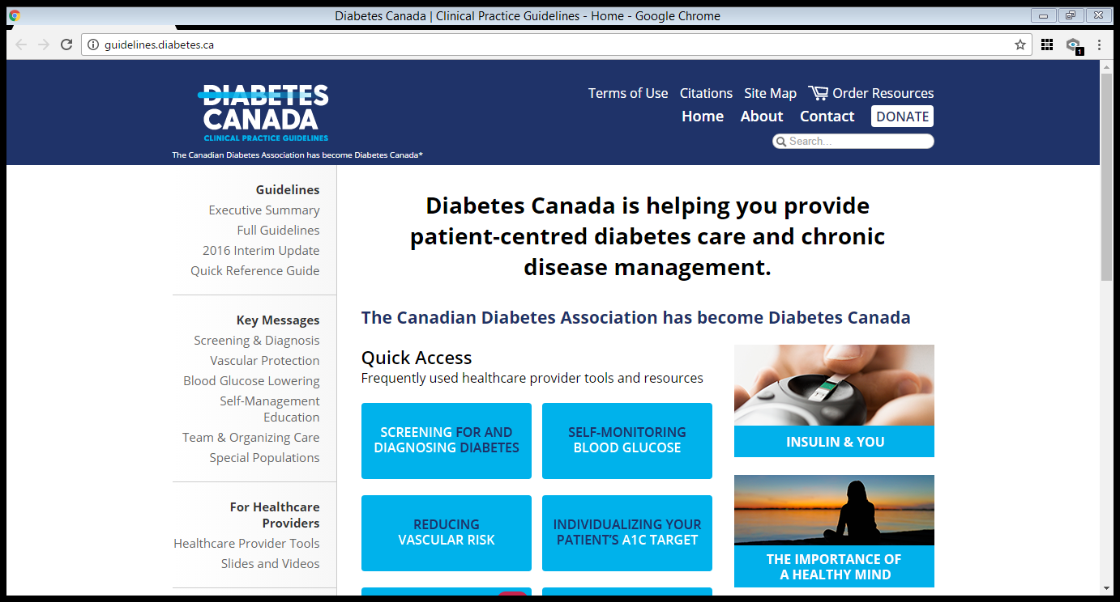

Slide 20
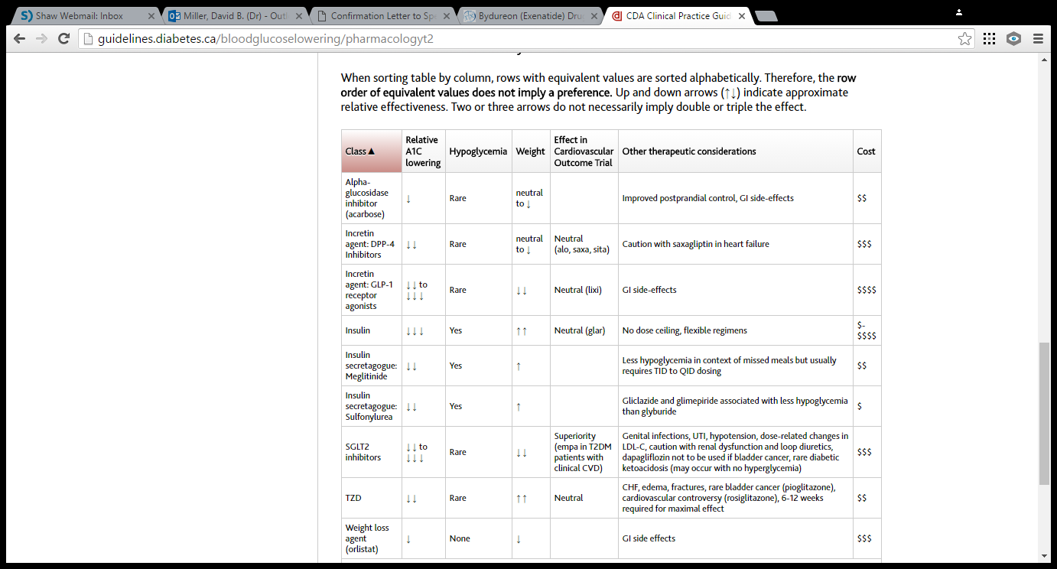

Slide 21
PREPARING FOR A PROCEDURE
Drug class | Hold day before ? | Need to do some SMBG ?
Metformin | If GFR < 50 | No
Sulfonylurea | No | Yes
Acarbose | Yes | No
TZD | No | No
GLP1 – RA | Yes | No
DPP IV inhibitor | No | No
SGLT 2 inhibitor | Yes | No
Insulin | No, modify | Absolutely

Slide 22
PREPARING FOR A PROCEDURE
WHAT ABOUT INSULIN ?
GENERAL PRINCIPLES
Want to avoid hypoglycemia and, hyperglycemia causing dehydration
Want to avoid dehydration causing hyperglycemia too
Many patients need to be able to do self-monitoring of blood glucose (SMBG)
Clear fluids tend to be high in rapidly absorbed carbohydrates
Never withhold insulin from a type 1 diabetic !!!
Bolus (aka prandial) insulin is for meals; Basal insulin is to suppress hepatic
production of glucose (gluconeogenesis)
So, bolus insulin may / will need adjusting; basal typically does not
Hypoglycemia, at any time, can be treated with glucose tabs or clear (apple) juice

Slide 23
PREPARING FOR A PROCEDURE
WHAT ABOUT INSULIN ?
SPECIFICS
Evening basal – decrease by 10% but take at usual time
Morning basal – decrease by 10% but take at usual time, even on
day of procedure
Premixed insulin (this is the tricky one) – decrease by 10% and take at usual time
on prep day, hold on morning of procedure, take with late breakfast or at
supper
Basal – bolus insulin – basal rules as above; bolus based on carb intake + correction
for hyperglycemia; hold bolus on morning of procedure (except for
correction), take with late breakfast or resume at lunch

Slide 24
NEW TECHNOLOGY

Slide 25
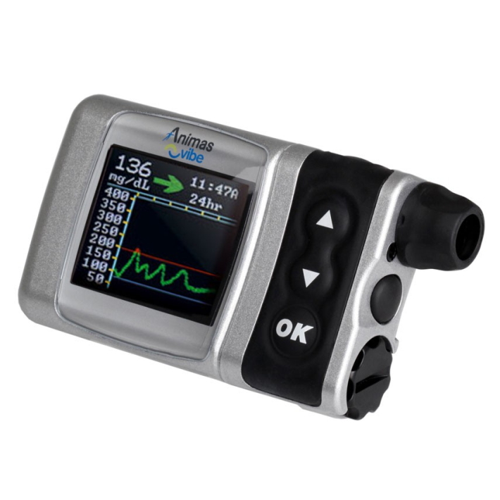
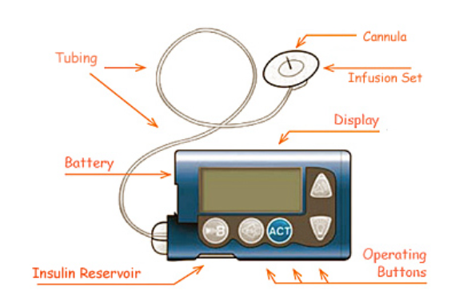
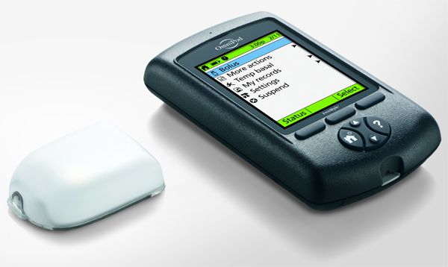
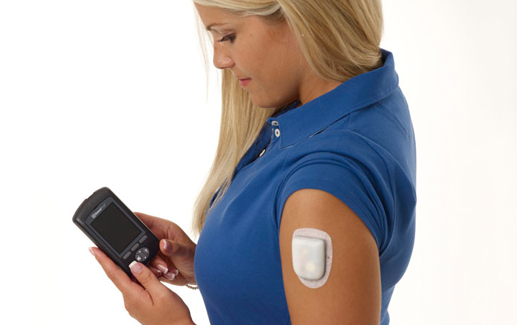
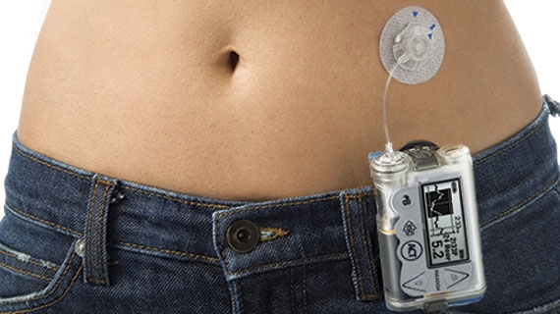
Insulin Pumps

Slide 26
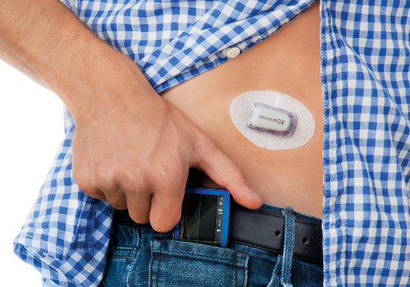
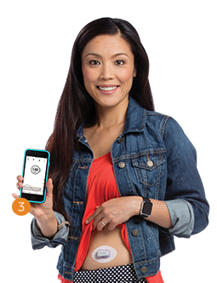
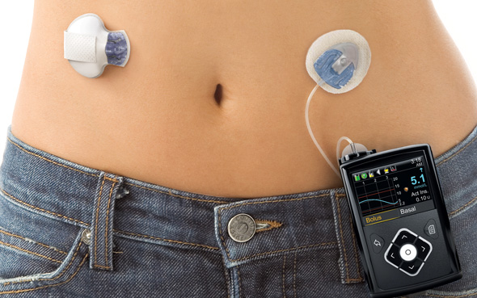
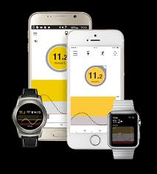
CGMS – Continuous Glucose Monitoring
Systems

Slide 27
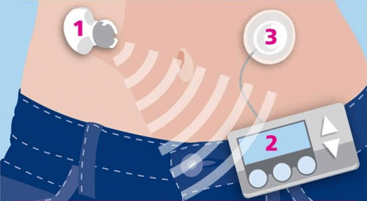
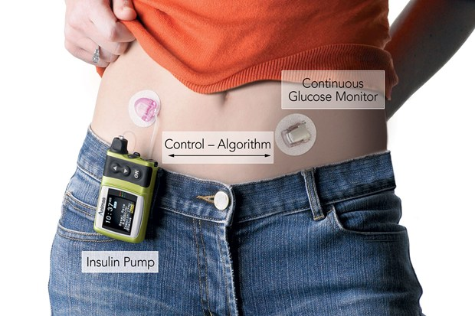
Closed loops
Aka bionic pancreas
Aka artificial pancreas

Slide 28
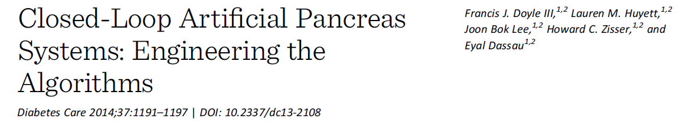
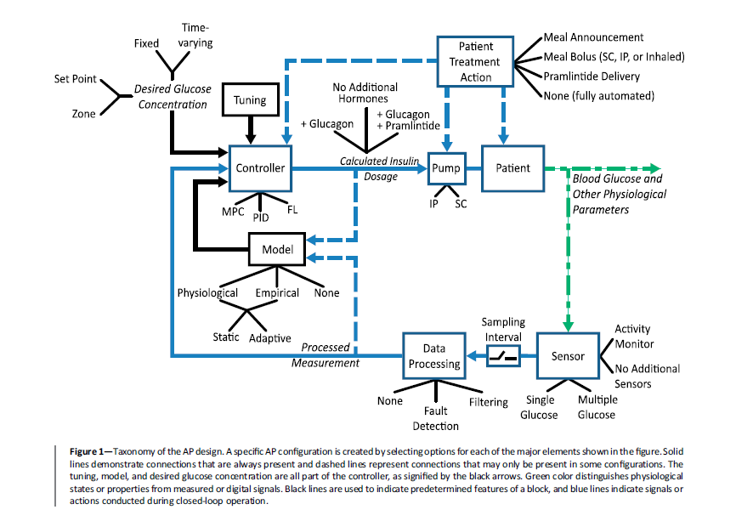

Slide 29
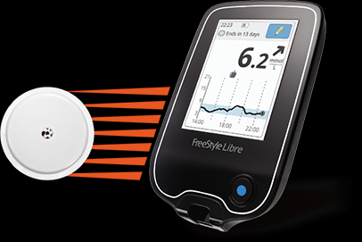

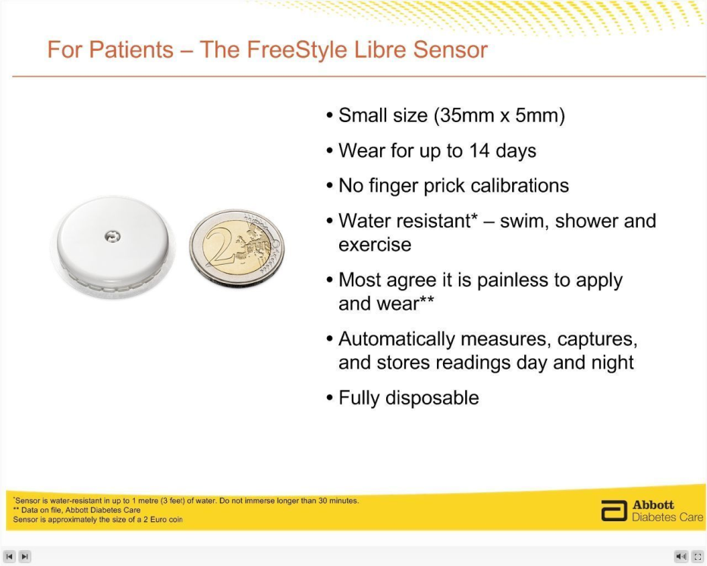
FGMS – Flash Glucose
Monitoring System

Slide 30
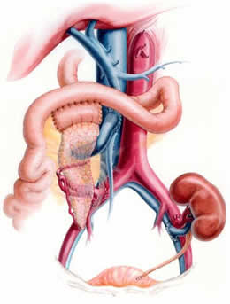
Kidney + pancreas
Transplantation
SPK or PAK

Slide 31
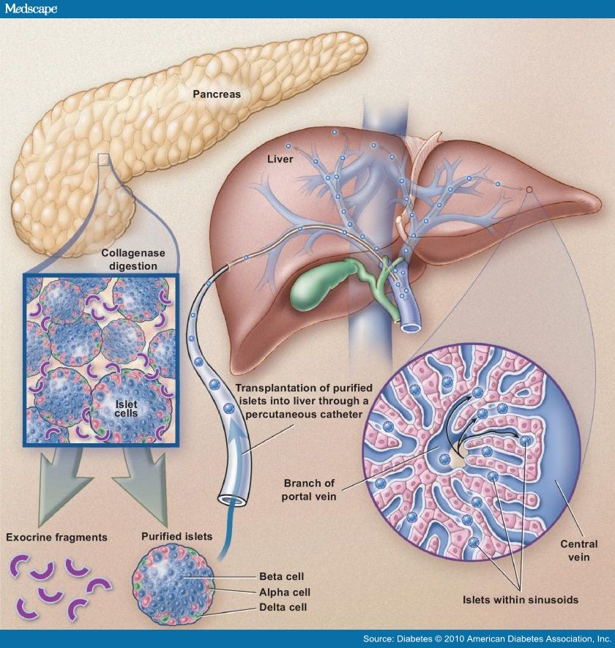
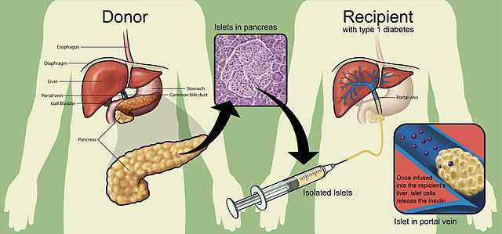
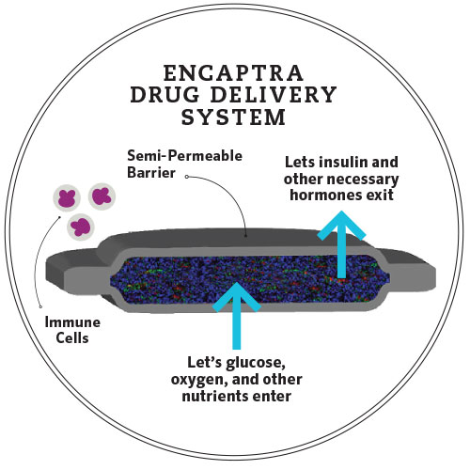
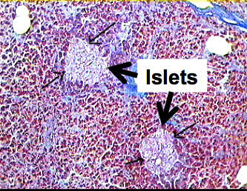
Islet and
Stem cell
transplantation

Slide 33

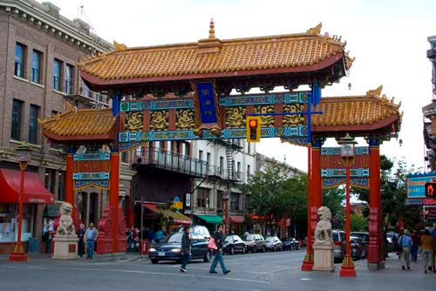
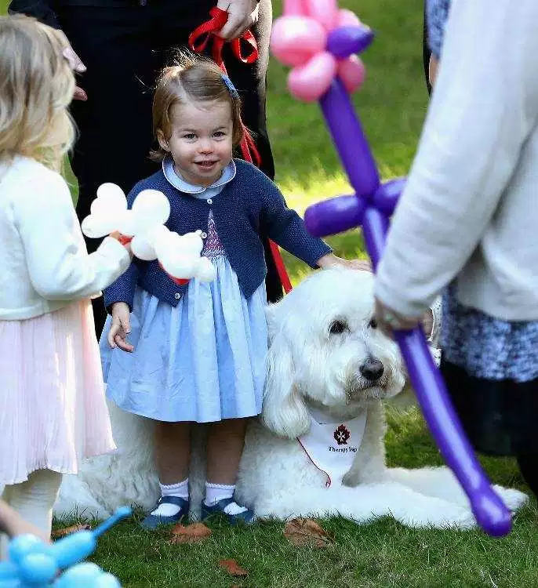
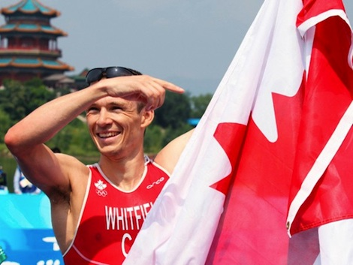
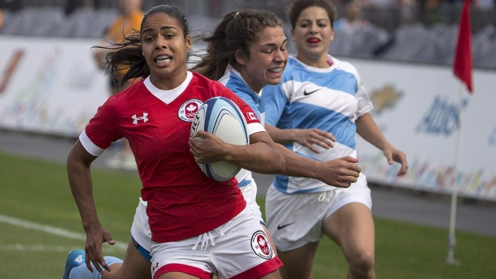
THANKS AND QUESTIONS

